Slide 1
Adobe Photoshop Essentials

Slide 2
Agenda
KWL Chart
What is Photoshop?
Elements of Photoshop
Getting Started
Learning Resources
Demo

Slide 3
What is Photoshop?

Slide 4
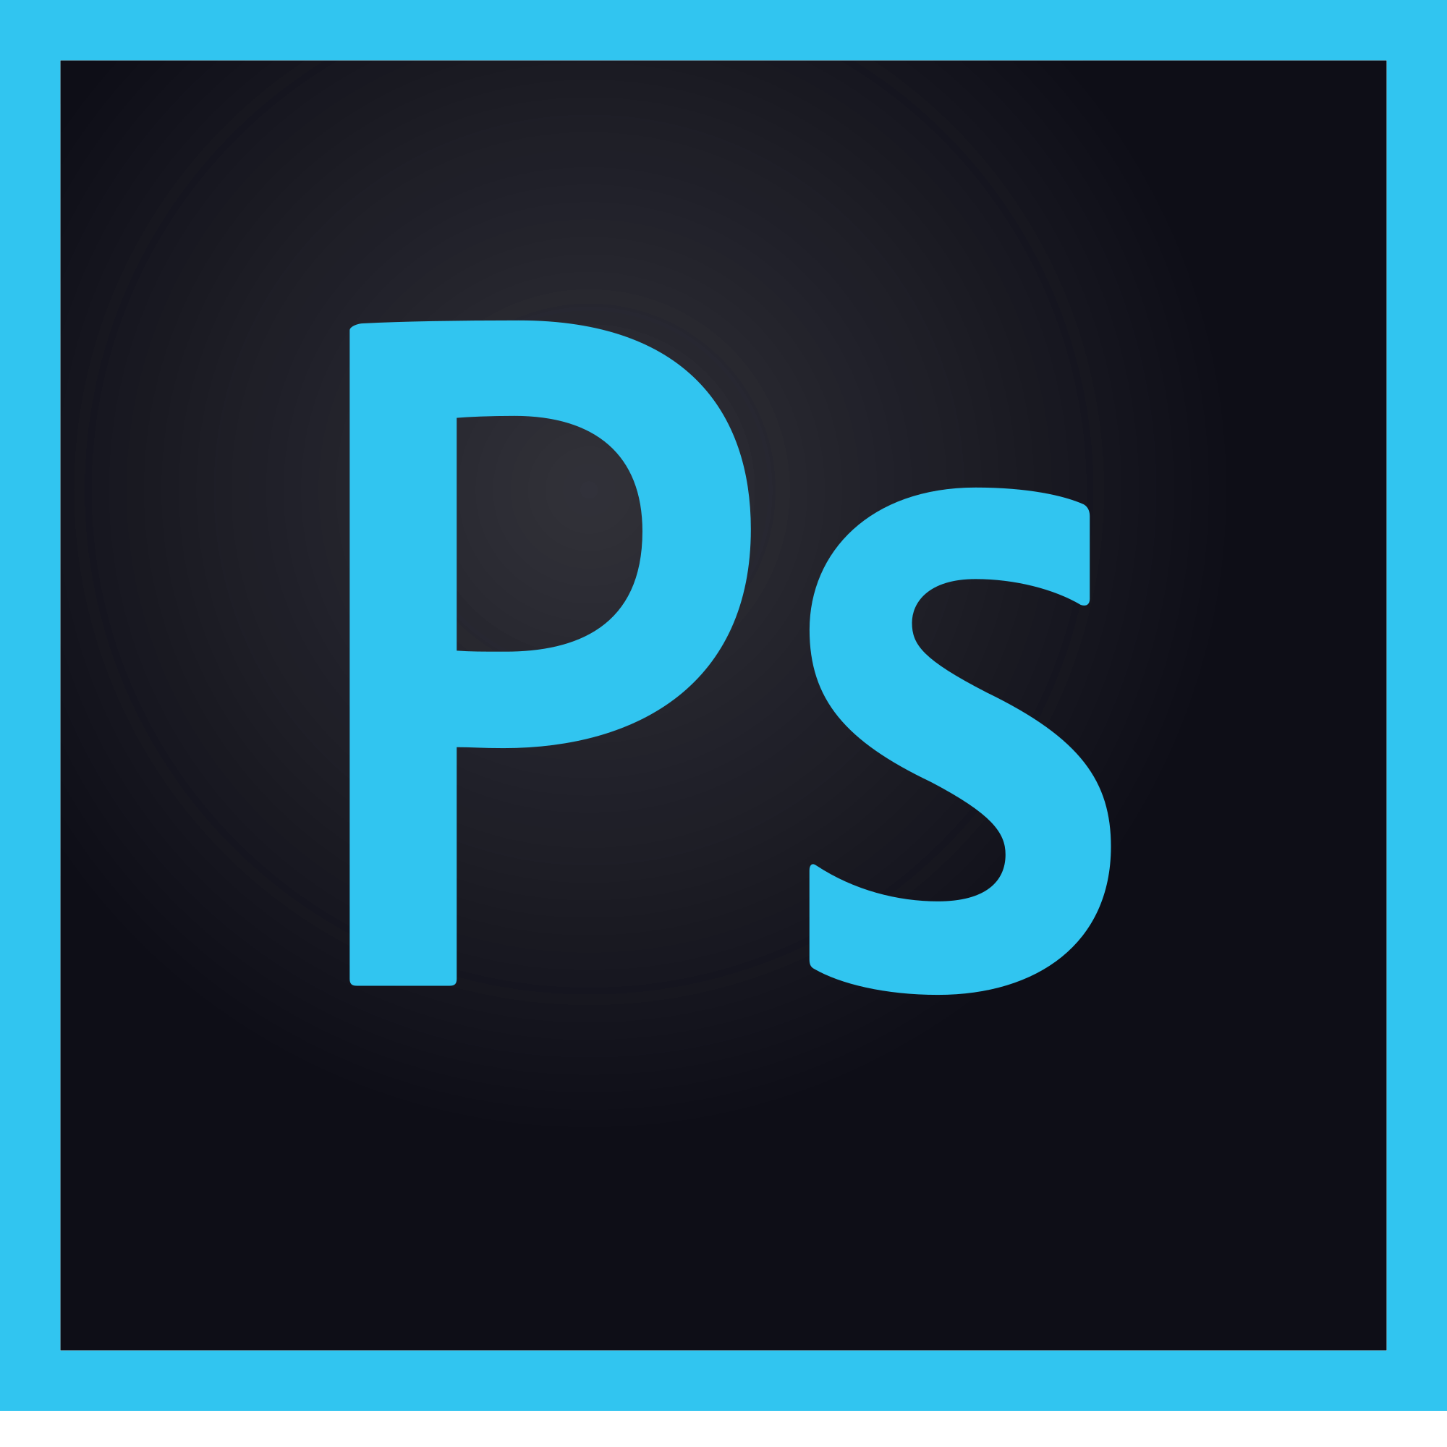
Photoshop is:
a professional image editing software designed by Adobe
used by graphic artists, designers, and photographers for print and web
a vast tool set
available for Mac and Windows

Slide 5
Common Uses
Edit existing images
Touch up, remove blemishes, enhance, and manipulate
Restore old photos - Class offered on Wed. Jan. 24
Create images and high quality graphics by adding text
Combine images together into a composite

Slide 6
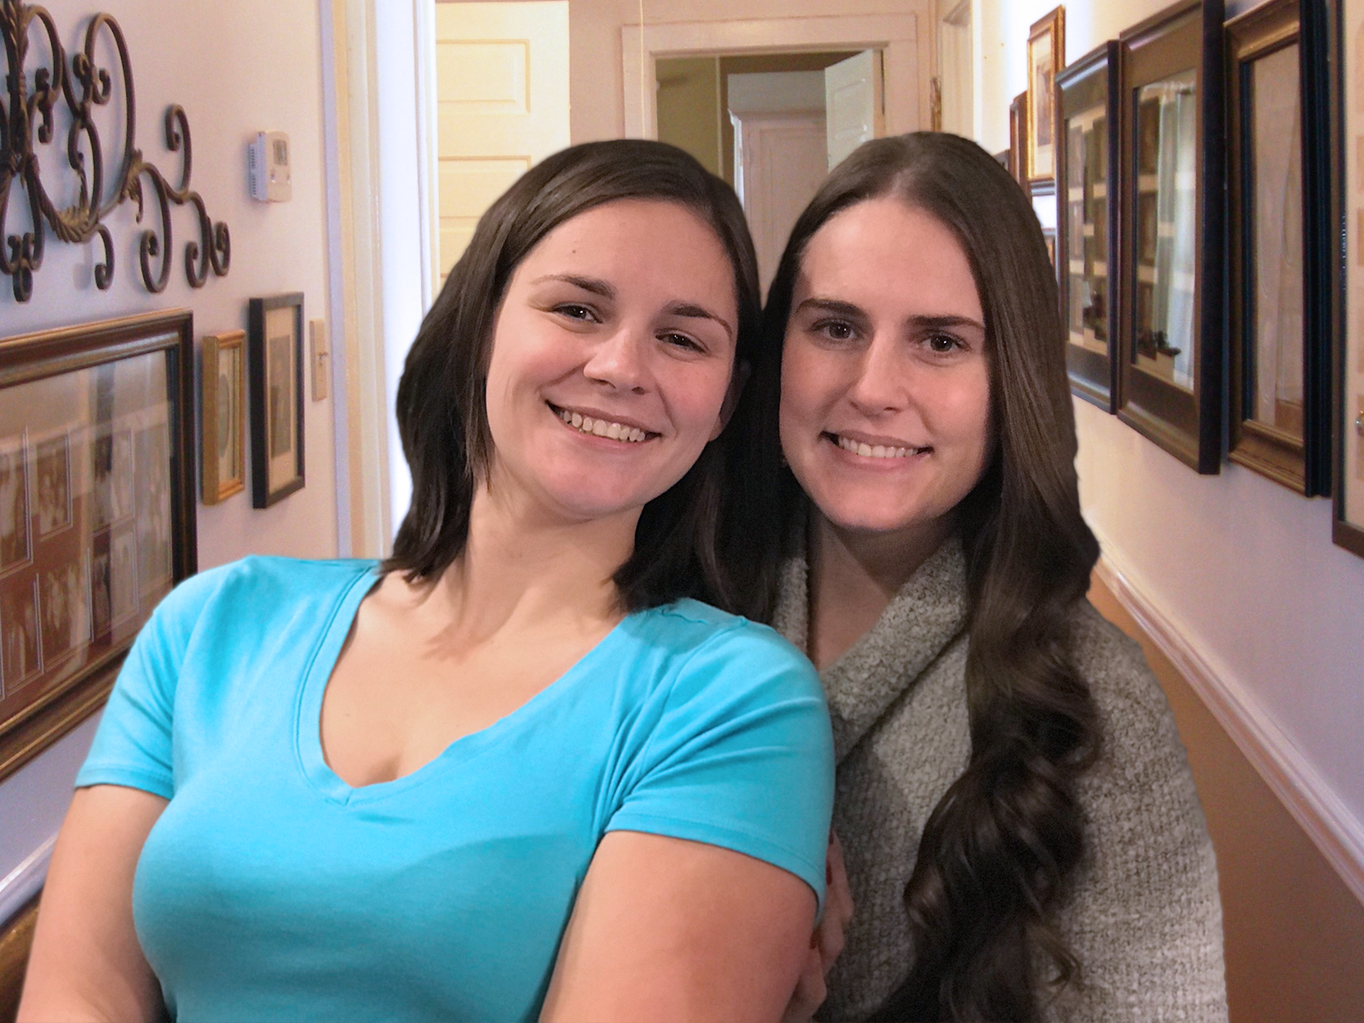
Example of composite

Slide 7
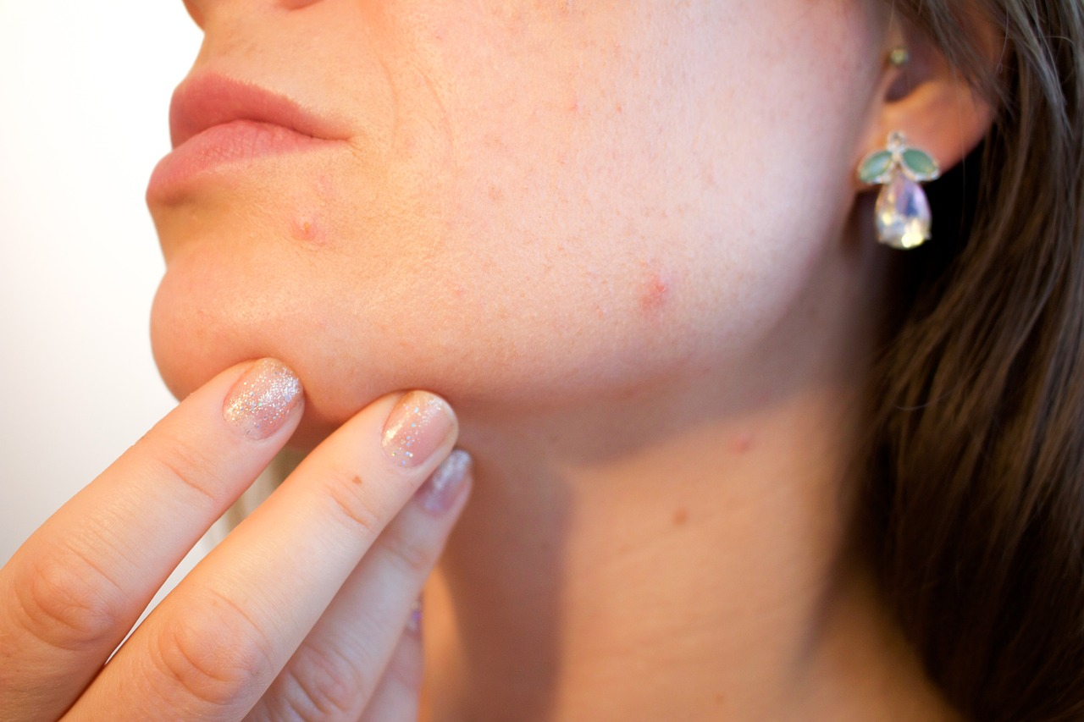
Example of retouching

Slide 8
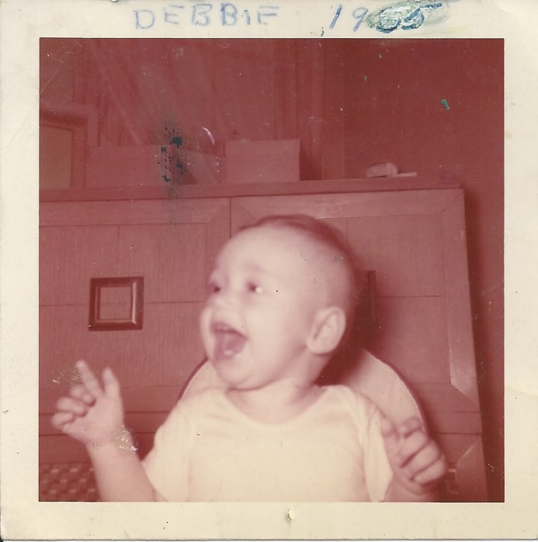
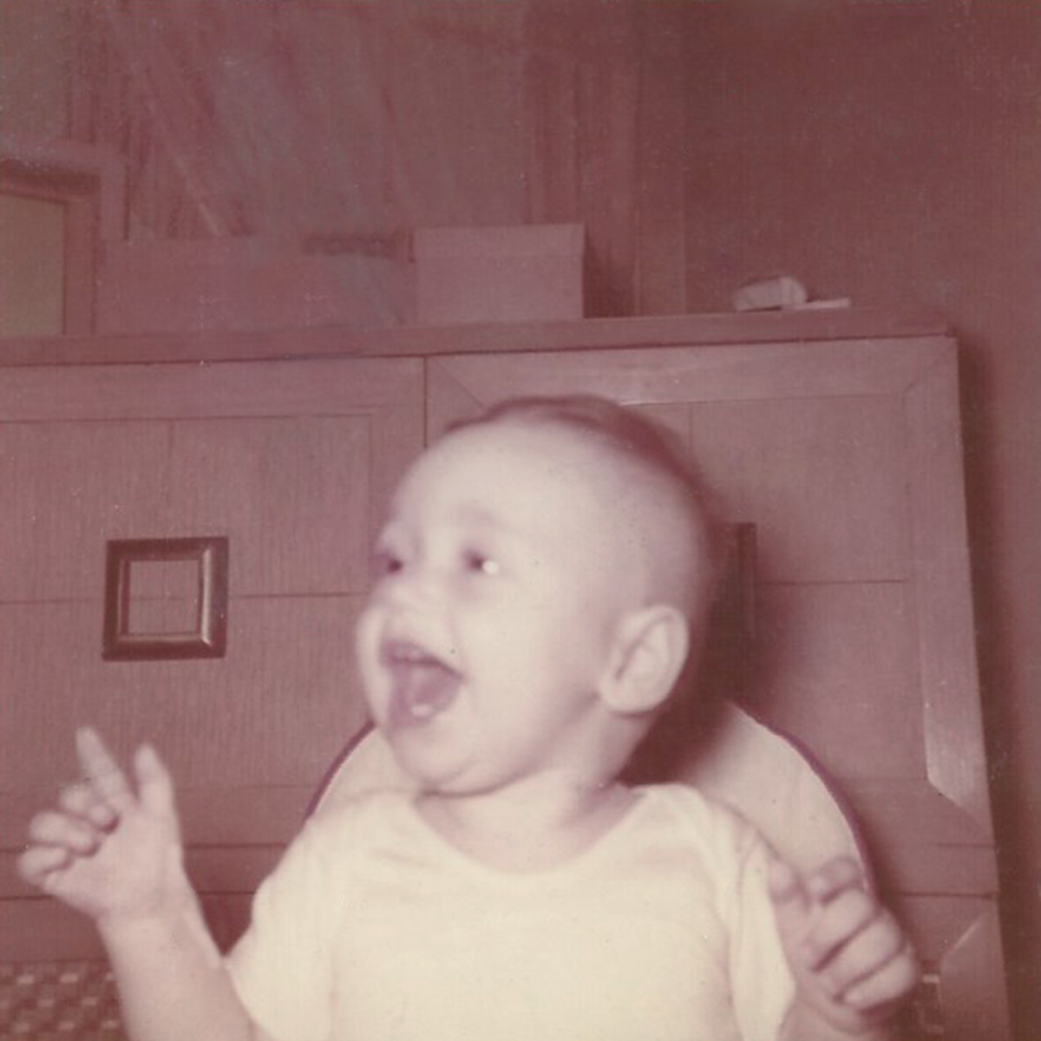
Example of restoring an older photo

Slide 9
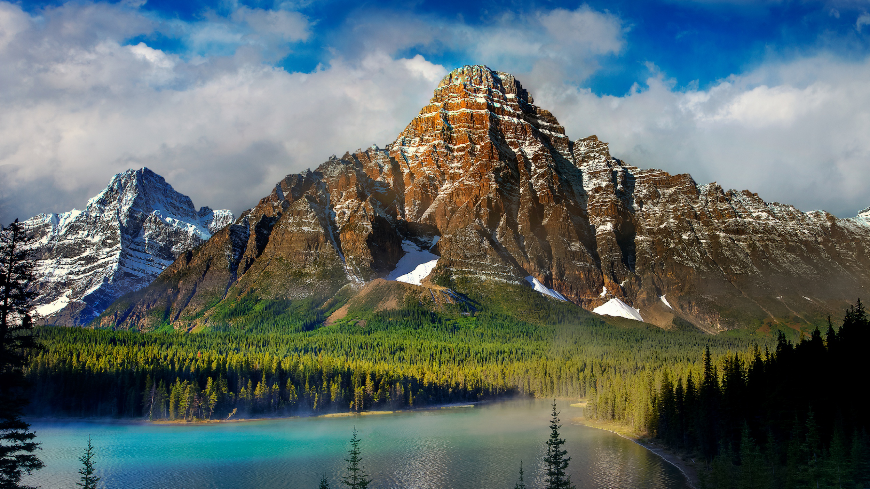
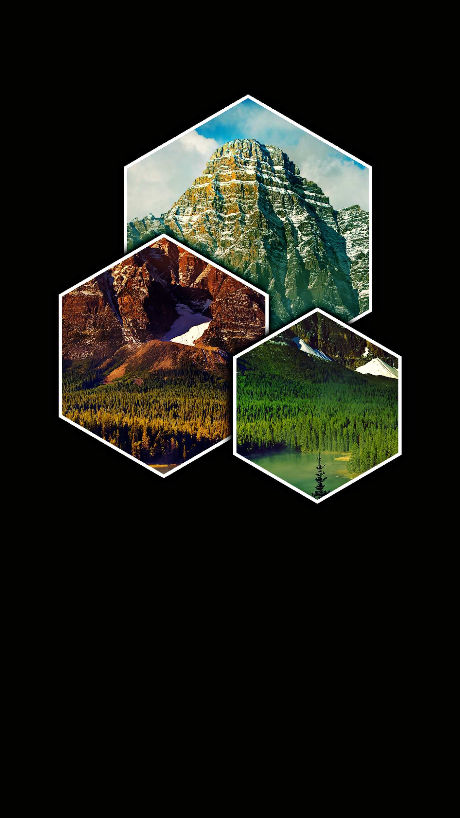
Multi-Layered designs

Slide 10
Sample Projects
Adobe Photoshop Twitter
Unsplash

Slide 11
Costs and Space
Free trial lasts seven days
Subscription based: $10/month or $120/year
Powerful program that takes up significant memory on your computer
Consider Photoshop Elements (PSE) as an alternative
Contains many of the same tools
Less intimidating interface
Buy the software for $60 - $100 instead of leasing

Slide 12
Elements of Photoshop

Slide 13
Layers
Layers, within Photoshop are means of organizing and manipulating specific part of an image
Layers allow for specific parts of an image to be altered without affecting other layers (i.e. non-destructive editing)
You can change the visibility, order, and combine layers

Slide 14
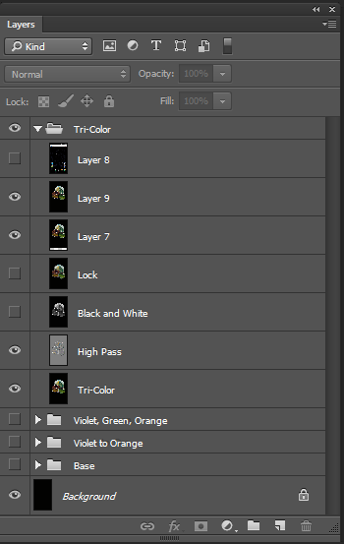
Layers Palette
Separate each step of your work
Each layer can have separate effects applied it it

Slide 15
Adjusting the Image
Adjustments
Adjustments are a set of operations that enable the user to enhance an image
Basic adjustments can manipulate an image’s hue and saturation, levels, contrast, curves, and color balance
Levels
The levels adjustment layer is a tool that allows you to stretch and squeeze the black and white values of a photograph to maximize certain attributes, such as saturation and brightness

Slide 16
Selection
Selection in Photoshop allows you to create a space in a project that travels between layers and can be used to mark, edit or create a specified layer.
All selections are distinguished by a crawling dashed line surrounding the areas selected. Once created, selection allow you to edit the area within their bounds.
Use selections to create masks. Masking is the practice of creating a space in which only on part is viewable or editable.

Slide 17
Brushes
More than a tool for painting a drawing
Many tools (including the quick select tool, clone stamps, eraser) use brush mechanics and concepts to operate
A brush is made up of 3 components: size, hardness, and a preset shape
Brush size: is measured in pixels and relates to the diameter of the brush
Brush hardness is the edge shape of the brush preset

Slide 18
RGB v. CMYK
RGB color is a color model in which Red (R), Green (G), and Blue (B) light sources are added together in different strengths and combinations to give a full array of colors. This color model works well for digital media because the same process is used to create color on the majority of screens.
CMYK is the primary color model for print. From home printer to professional publishing operations, printers generally combine Cyan (C), Magenta (M), Yellow (Y), and Black (K) to create dynamic color anges on a variety of media.
Because these color modes are fundamentally different, it is always important to match the color model with the intent. This can be chosen when you a create a document or by locating Image > Mode.

Slide 19
Selecting Color
Color Picker
Located in the bottom of the tool bar, you will see two overlapping squares filled with black and white
Click to switch between background/foreground or double click on a square to select a new color in the color picker

Slide 20
Working with Type
Type Tool
Tip: Always make the type box larger than the type you want to put in it. This will allows you to manipulate the type without it disappearing (being overset)

Slide 21
Getting Started

Slide 22
Size and Orientation
Mode: Type of color (CMYK or RGB)
Image Size: change size of image
Canvas: change size of canvas
Rotate canvas: change orientation of canvas

Slide 23
Saving Your Work
.PSD - Adobe photoshop uses photoshop document of PSD file format by default. Layers are preserved in this file format.
.JPEG- The joint photograph experts group (.jpeg, .jpg, jpe) file name extension is used for digital photography
.GIF- th graphics interchange format or GIF (.gif) file name extension is popularly used for creating web pages, elements, logos, etc.
.PNG-the portable network graphic or PNG (.png) format was designed as an alternative to GIF and JPEG formats.
.TIF-the tagged image file format or TIFF (.tif, .tiff) saves and preserves all of the original image data.

Slide 24
More Resources

Slide 25
Free Software
Canva
Gimp
Paint.net
Pixlr
Photos(MacOS)
Photo Editor (Windows)

Slide 26
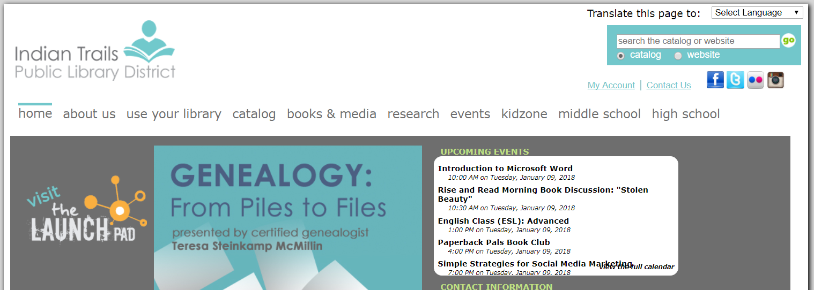
Tutorials and Classes
Books
Easy Steps Series
Teach Yourself Visually
Online Resources
Lynda.com
Gale Courses
YouTube

