Slide 1
Cutting the Cable Cord
Crystal Lake Public Library
Adult Services Department
126 Paddock Street
Crystal Lake, IL 60014
815-459-1687 ext. 7

Slide 2
Disclaimers
Cutting the cord may not be for you!
This presentation is informational only – no endorsements or recommendations intended.

Slide 3
True or False?
Cutting the cord means you don’t have to pay anymore.
False!
You still need pay for content, but there are opportunities to save money.

Slide 4
More and more households are turning to streaming…
In 2013:
900,000 U.S. households dropped their cable service
TV-less households tripled since the previous year

Slide 5
Why?
The Internet
Internet Streaming services such as Amazon Prime, Hulu, Netflix
And from July 2013 – July 2014, the average cable TV bill went up by 5.8%

Slide 6
Tonight We Will Cover…
Subscription or pay-as-you-go content providers
Devices that allow streaming to TV
Digital antennas
What you can get with your library card

Slide 7
What is streaming video?
Video is played immediately after data is received
File is not stored permanently in the destination device - no downloading takes place
Ever watch a YouTube video?
Streaming video!

Slide 8
You will need 2 things for Streaming Video:
Content Provider
Device

Slide 9
3 Digital Distribution Strategies
Direct-to-consumer
HBO Now
CBS All Access
Indirect (aggregators)
Netflix
Amazon Prime
Pay TV service via cable or satellite
Joint-owned
Hulu (owned by NBC, Disney & Fox)

Slide 10
Content Providers

Slide 11
$7.99+ per month (free trial = one month)
Known best for streaming movies and DVD mail delivery
Has the most back episodes of TV shows
Exclusive original series: House of Cards, Marco Polo and Orange is the New Black
Includes documentaries, Ted series, award winners, and content you can’t get elsewhere
No commercials, no contract, cancel anytime
Cons
Frequent catalog changes due to licensing contracts
New season not available until the DVD is released

Slide 13
$99 per year (free trial = 30 days)
Past episodes of many TV shows: Downton Abbey, Numb3rs, The Good Wife (Current episodes for purchase)
Amazon original TV series – Transparent, Bosch
Variety of movies for free or low-cost rental
Older HBO series such as The Sopranos
Other benefits:
Free 2-day shipping
one free Kindle book per month
Prime Music
Prime Photos

Slide 14
Cons
New season not available free until the DVD is released, but will allow you to purchase currently airing episodes.
Frequent catalog changes – same as Netflix

Slide 15
7.99 per month (free trial = 1 week)
Current (and older) episodes from ABC, NBC, Fox, The CW, Comedy Central, MTV, and Univision including Once Upon a Time, Revenge, The Tonight Show and American Odyssey
They’ll tell you where you can find something if they don’t have it
Huge catalog of Criterion titles
Cons
Advertising! 3-4 commercial breaks per episode
No full seasons to binge watch
No CBS network shows

Slide 16
$5.99 per month (free trial = 1 week)
Current (and older) episodes from CBS including Blue Bloods, The Good Wife, NCIS, Elementary and The Young and the Restless
Classic TV shows include Frasier, I Love Lucy, JAG, MacGyver and Star Trek
Cons
Only CBS
Not available on any media hubs (only access is via the website, iOS app or Android app)

Slide 17
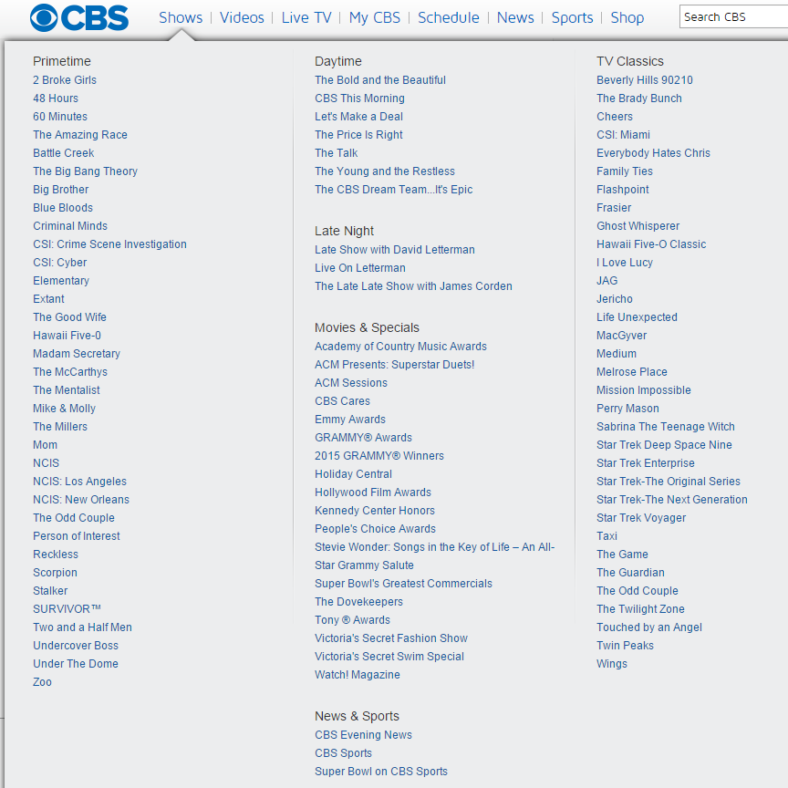

Slide 18
$14.99 per month (free trial = 30-days)
HBO NOWSM is the new standalone streaming service from HBO
Get instant access to all of HBO, including every episode of every season
Subscribe from your Apple device (Apple TV, iTunes, any device running iOS or MacOS)
Cons
Only available via Apple devices – according to the website, more providers will be joining soon

Slide 19
$20 per month (free trial = 1 week)
Their “Best of Live TV package” includes: ESPN, AMC, HGTV, TNT, A&E and others.
Can add other options for an additional monthly fee (e.g. HBO is an extra $15/mo; Sports Extra is $5/mo)
Internet-based
No long-term contract
Cons
Not available over the web (but there are apps)
Can’t stream in multiple places simultaneously

Slide 20
Sign-up is free – no subscriptions or late fees
Own or rent only what you want
Watch on any device – at home or on the go
Watch weeks before DVD release and months before Netflix
Can store your own movies in the cloud
Cons
Every item costs $
From their license agreement “If you purchase Content, you may view it for as long as you (i) are capable of accessing the VUDU Service, and (ii) maintain an active VUDU Account.”

Slide 21
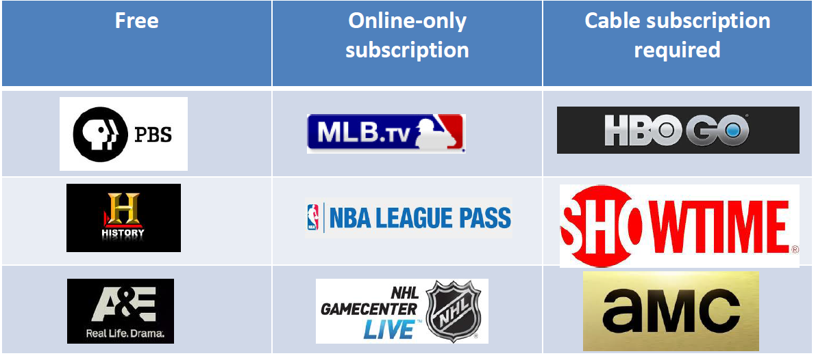
Other Streaming Content Providers

Slide 22
Not sure where to find your favorite shows?
Try http://www.canistream.it/

Slide 23
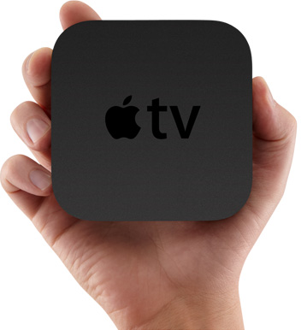
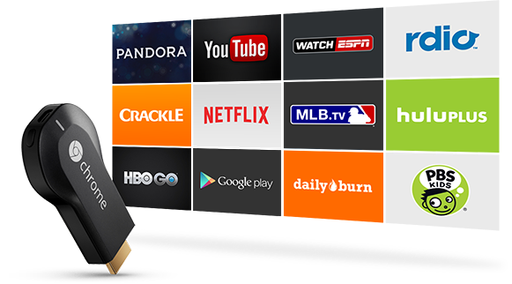
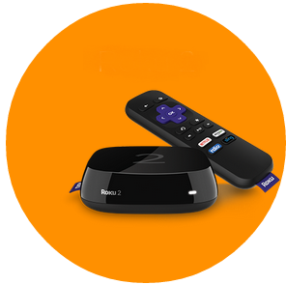
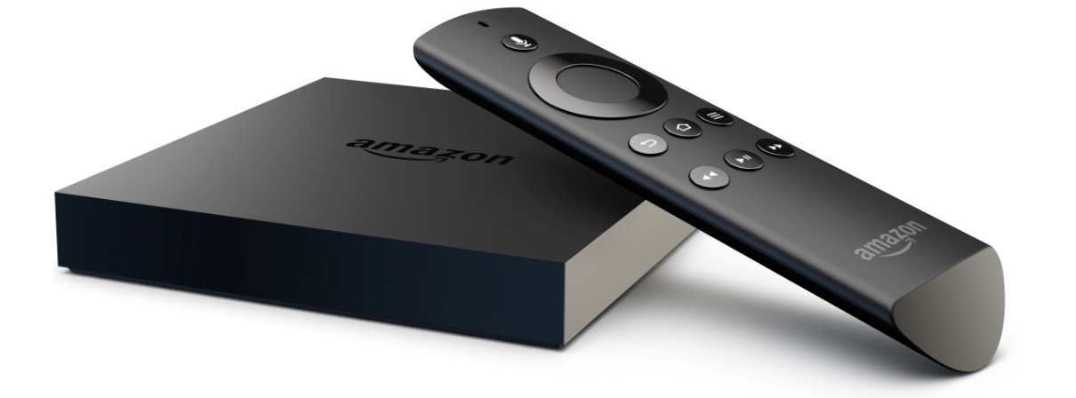
Devices (aka media hubs)

Slide 24
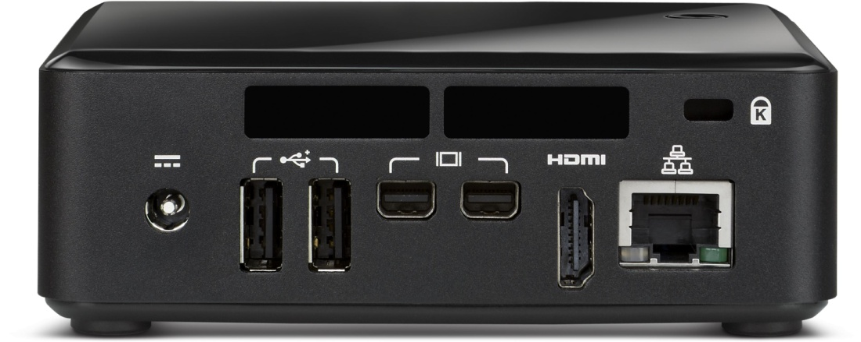
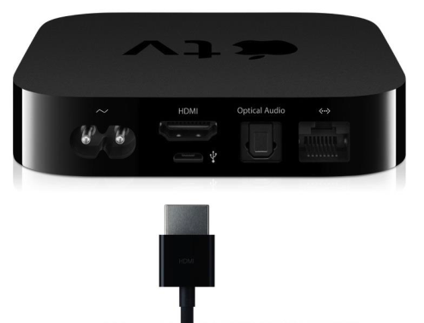
Devices plug into the HDMI port. If you do not have an HDMI port, you will not be able to stream to your television [unless you use the Roku 1].

Slide 25
Apple TV
$69 for the device
Requires HDTV (high-def TV) & HDMI cable
Apps – HBO, NetFlix, HuluPLUS, ESPN, MLB, NBA, ABC, PBS, YouTube, Crackle [Notably absent: AmazonPrime – Buy episodes from the iTunes store
AirPlay – Mirrors whatever is on your Apple device to the big screen
Notes:
Apple TV gives you access to the best 1080p HD content — including blockbuster movies, hit TV shows, live sports, your music, photos, videos, and more — right on your high-definition TV. You can even play content from your iOS device or Mac on your TV using AirPlay. Apple TV requires an HDMI cable (sold separately).

Slide 26
Chromecast
$35 for the device
Requires HDMI port on your TV
Apps: similar to Apple TV offerings
Buy episodes from Google Play
Screen mirroring from any chrome browser
Remote not included –controlled from device with Chrome browser
Notes:
Chromecast is a thumb-sized media streaming device that plugs into the HDMI port on your TV. Simply use an Android phone, tablet, iPhone®, iPad®, Mac or Windows laptop, or Chromebook to cast your favorite entertainment and apps right to the big screen.

Slide 27
Roku
$50 -$100 depending on model
Roku Stick similar to Chromecast
Roku 1 works with older TVs
Roku 2 & 3 do not require wireless Internet
Roku 3 has voice search
Huge amount of apps
Includes remote
Special search option allows you search by show across apps
M-GO (integrated movie store)
Notes:
Roku Stick: The Streaming Stick requires an HDTV with HDMI® input.
Roku 1: Older TV. No problem. Roku 1 comes standard with Composite cables just in case your TV doesn't have HDMI. For full HD, you'll need HDMI® though.
Roku 2: No wireless, no problem. Roku 2 features Ethernet, a USB connection for personal media, and a microSD card slot to expand internal storage.

Slide 28
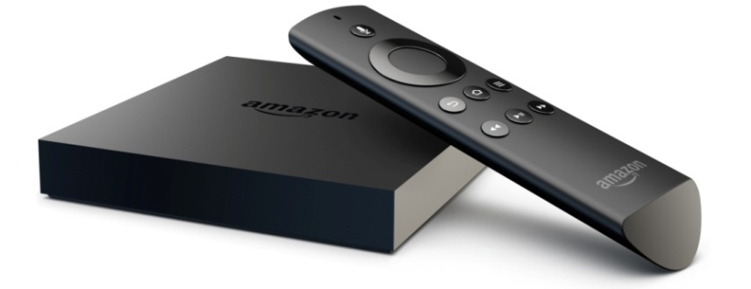
Amazon Fire TV
$99 for the device
Requires an HDTV
Apps similar to others
Voice search
Games (game controller extra)
Notes:
Amazon Fire TV is a tiny box you connect to your HDTV. It's the easiest way to enjoy over 200,000 TV episodes and movies on Netflix, Amazon Instant Video, and HBO GO, plus games, music, and more.
With voice search, simply say the name of what you want to watch and start enjoying in seconds

Slide 29
Amazon Fire TV Stick
$39 for the device
Requires an HDMI port
Apps similar to others
Easy to connect to any HDTV – you can move it from room to room.
Voice search
Games (game controller extra)
Mirror your phone or tablet to your TV
Notes:
Amazon Fire TV Stick connects to your TV's HDMI port. It's an easy way to enjoy over 200,000 TV episodes and movies on Netflix, Amazon Instant Video, HBO GO, and Hulu Plus, plus games, music, and more
Sync photos from all your devices
With Fire TV stick photos or videos you take on your phone or tablet can be automatically uploaded to Amazon Cloud Drive, so they appear on your HDTV. Prime now includes free storage in Amazon Cloud Drive for your entire photo collection.

Slide 30
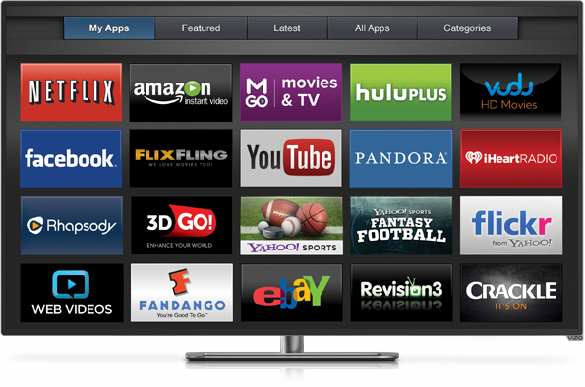
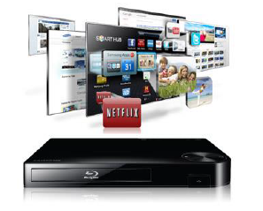
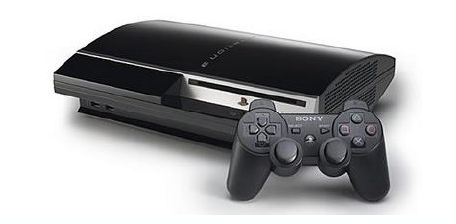
Other Devices
Smart TVs
Digital Blu-ray players
Game Consoles
Notes:
Smart TVs, Blu-ray players and game consoles have built in apps, app stores and Internet networking

Slide 31
Digital Antennas
Good solution for watching shows and games on basic cable when you need to see it right now!
Check tvfool.com or antennaweb.org to check what kind of antenna you will need for your address.

Slide 32
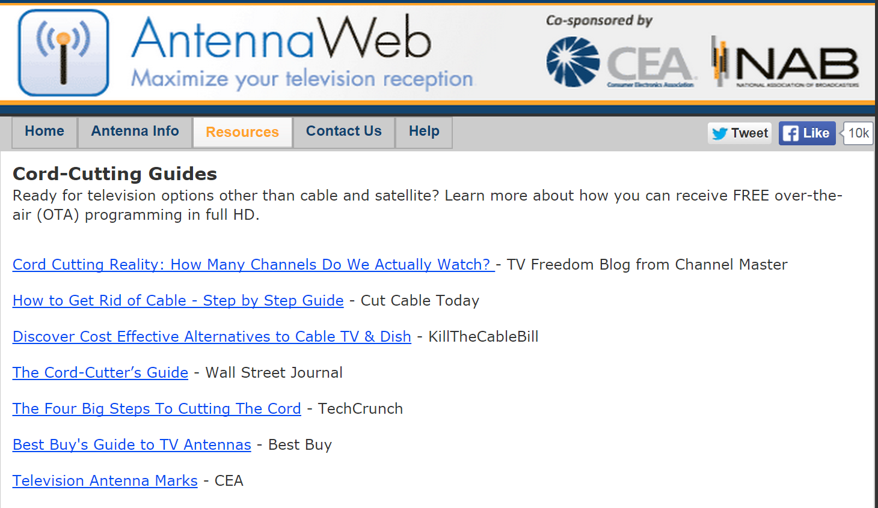
Cord-Cutting Guides

Slide 33
At the Library
Thousands of titles on DVD/Blu-Ray including Foreign Films, Anime, Children’s
Digital Magazines – using Flipster

