Slide 1
Tech Tuesday: Using the Internet http://pbdd.org/wp-content/uploads/2015/07/PRC-TechTuesday-UsingTheInternet.pptx
Getting started with
using the Internet for daily activities

Slide 2
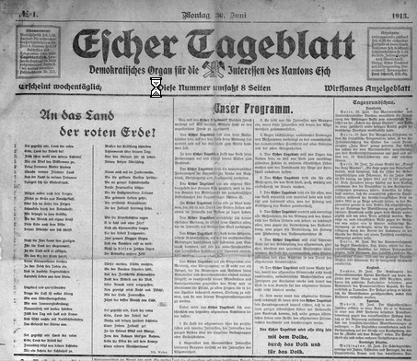
Life Before the Internet (1 of 7)
Media
Newspapers & Magazines
Radio
Television
Movies
Home Movies
Classified Ads

Slide 3
Life Before the Internet (2 of 7)
References
Libraries
Maps
Phone books
Encyclopedias
Experts
Technical Publications
Cookbooks

Slide 4
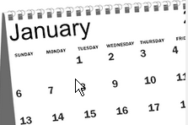
Life Before the Internet (3 of 7)
Personal Organizing Systems
Calendar
Address Book
Checkbook
Household management
Restaurants
Recommendations, Reservations, Waiting in line, Menu, Ordering

Slide 5
Life Before the Internet (4 of 7)
Social Networks
Telephone calls
Letters
Dating
Passing notes
Games
Discussions
Preachers
Teachers
Gossip
Party Invitations

Slide 6
Life Before the Internet (5 of 7)
Professional Networks
Resume sharing
Letters of Recommendation
Word-of-mouth job openings
Background Checks
“Old boys club”

Slide 7
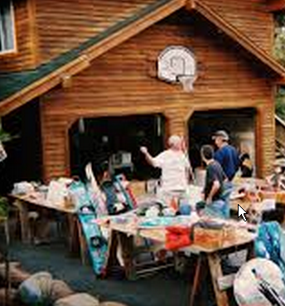
Life Before the Internet (6 of 7)
Stores
Bookstores
Record Stores
Garage Sales
Used Car Lots
Repair Shops
Banks
Stock Brokers
Insurance Agents
Grocery Store

Slide 8
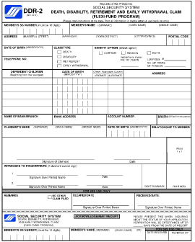
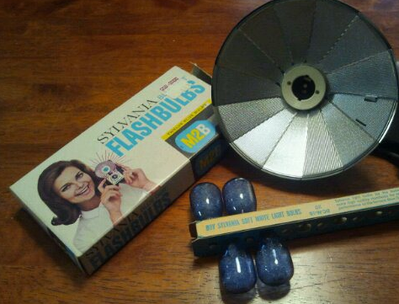
Life Before the Internet (7 of 7)
Other Things
Foreign Language Dictionaries
Exercise
Informational Brochures
Government Forms
Advertisements
Con Artists
Pornography
Hoaxes & Chain mail

Slide 9
Life With the Internet – Yes And … (1 of 7)
Media
Newspapers & Magazines + on-line, immediate + Twitter + blogs + e-zines + web comics
Radio + streaming, global, archive, podcasts
Television + on-line archive, NetFlix, Hulu, Amazon
Movies + NetFlix, Amazon, YouTube independent productions, trailers & parodies
Home Movies + YouTube
Classified Ads + CraigsList, Ebay, FreeCycle

Slide 10
Life With the Internet (2 of 7)
References
Libraries + catalog/account access + Gutenberg.org, on-line publishers
Maps + Maps.Google.com + GPS
Phone books + 411.com + social network
Encyclopedias + WikiPedia, etc
Experts + forums + FAQ + Ehow.com, Ask.com + on line help chats
Technical Publications + many are on-line
Cookbooks + global recipe sharing

Slide 11
Life With the Internet (3 of 7)
Personal Organizing Systems
Calendar + cloud storage, shared visibility (Calendar.Google.com + Doodle.com)
Address Book + cloud storage, synchronizing with cell phone
Checkbook + transaction history, electronic payments + balance accounts + deposit checks
Household management + ISP bill + manage utility bills + “smart house” devices
Restaurants
Recommendations, Reservations, Waiting in line, Menu, Ordering + all this on-line

Slide 12
Life With the Internet (4 of 7)
Traditional Social Networks + FaceBook + Pinterest + Instagram
Telephone calls + Skype + internet phones
Letters + email + messaging systems
Dating + Match.com, Tinder, FarmersOnly.com
Passing notes + Internet Chat
Games + on-line games (real-time & async)
Discussions + forums, archives, links, Twitter
Preachers + distributed congregations
Teachers + tutorials, on-line classes, certifications
Gossip + persistence + wider availability
Party Invitations + Evite (responses, updates)

Slide 13
Life With the Internet (5 of 7)
Professional Networks
Resume sharing + Monster, Dice, LinkedIn
Letters of Recommendation + LinkedIn
Word-of-mouth job openings + Referrals
Background Checks + Google Searches
“Old boys club” + LinkedIn Connections degrees

Slide 14
Life With the Internet (6 of 7)
Stores
Bookstores + Amazon.com, etc
Record Stores + iTunes, Google Play, etc.
Garage Sales + eBay + freeCycle
Used Car Lots + sellers + Edmunds + CarFax
Repair Shops + troubleshooting + buy parts
Banks + e-banking + on-line banks + EFT + Paypal
Stock Brokers + low costs + information + e-brokers
Insurance Agents + quotes + agents
Grocery Store + Peapod + Amazon pantry

Slide 15
Life With the Internet (7 of 7)
Other Things
Foreign Language Dictionaries + on-line translation (babelfish, translate.google)
Exercise + tracking & sharing on-line
Informational Brochures + most on-line
Government Forms + info, forms, filings
Advertisements- everywhere, tailored, can be invasive + software & precautions
Con Artists – email, phishing, malware, spyware, hoaxes + software & precautions
Pornography – easy to find, sometimes finds you + software & precautions
Hoaxes & Chain mail– + amusement & caring; - mailbox overload & panic + Snopes.com & careful consideration

Slide 16
Internet Additions
Cultural Impact
Information flows quickly
Changes happen rapidly
Internet “memes”
Blurred line between public & private
Social Networking
Technology
Video phone

Slide 17
Getting Started
What do I need:
A device (computer, tablet, phone)
An internet service provider
A web browser
Website destination or google.com

Slide 18
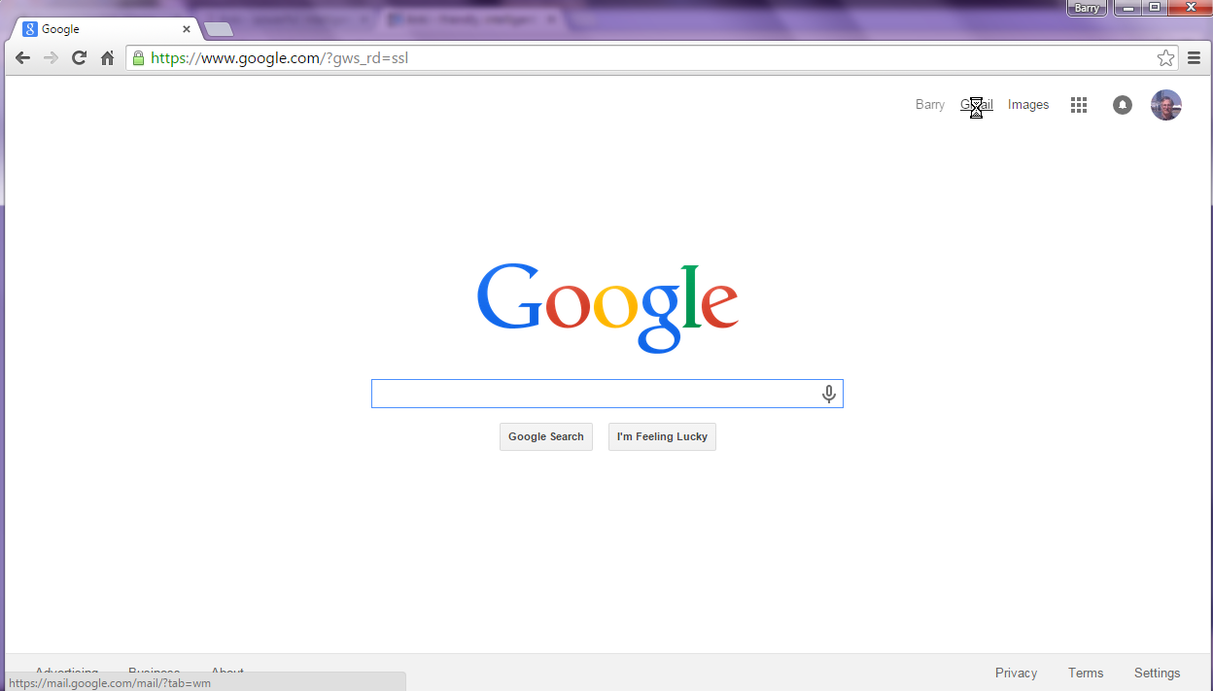
Most Important Parts of Web Browser
Tab(s)
Navigation
Controls
Address/Search
Bar
Windows
Controls
Main
area
Status
Area

Slide 19
Most Important Parts of a Browser
Address Bar: Tells you who provides the content of the main page, and lets you go to a site or search for content
Tabs: Each one can show a different web page, for doing multiple things at once
Navigation Controls: Let you go back to a previous page, or reload a current page
Status area: Tells you where a link will take you

Slide 20
Surfing Safely
Be aware of ads. They’re the price of “free”
In the main part, of the window, when your arrow cursor turns to a finger cursor , clicking on the thing you’re pointing to (link) will take you to a new web page
Before you click on the link, check the status line to see if it is taking you where you want to go
Be very cautious before you download files. They can contain viruses or other bad software

