Slide 1
Tech Tuesday: Managing Your Email Inbox
Steve Jenkins
July 14, 2015

Slide 2
An Outline for Today’s Session
Why manage your email?
What to do with your incoming email?
Deleting and forwarding email
Creating labels
Using filters
Other suggestions
Practice time/Questions

Slide 3
Why Mange Your Email Inbox?
A cluttered email Inbox hinders productivity, prevents you from maximizing your time, leads to frustration, and distracts you from other obligations.
More than one-quarter of a worker's day on average is spent answering and reading emails, according to research released in 2012 by the McKinsey Global Institute. Its survey found that email is the second-most time-consuming activity for workers, next to "role-specific tasks.“ (Source: Entrepreneur Magazine)

Slide 4
Tips for deciding what to do with incoming email
Act quickly-within 24-48 hours
Review your email Inbox every day
Delete junk mail, chain letters, unbelievable offers.(IE “Make 40,00 dollars in two days”)/Mark these as spam.
Forward it or answer it without any further action.
Keep it for reference (move it a folder or email.)
Mark as important by clicking on the next to the title.
Prioritize Inbox by listing important or starred messages first.

Slide 5
Deleting/Forwarding Email
To delete your entire email Inbox
Click the Select and All button in the upper right hand corner of the screen.
Click the Delete button (the trash can icon) at top of the page.
To delete some of your email Inbox, you must mark each message individually before deleting.
To forward an individual message, use the drop down menu at in the upper right corner of the screen and click the Forward button. Then type an address or name.
Use filters to forward your email.

Slide 6
Creating a Label in Gmail
In Gmail, folders are referred to as labels. In other email packages, they are referred to as folders.
Create new Label
To create a label/folder:
Find create new label link on the left side of the screen.
Enter a new label in the dialog box that appears.
New label will be listed on the left of the screen in alphabetical order.
Show and hide your labels by clicking the manage label link and then the show/hide button

Slide 7
Moving a Message to a Label
1. In order to move a message from the Inbox to a label, you need to use the move button at the top of the screen. Under this button, there is a drop down box next to the icon which allows you to select a label.
2. If you want to copy a message and save it in the Inbox and the label, use the label as button.
3. An example: Here is a how I moved one of my messages into a label:
Selected “Tech Tuesday power points”,
Used drop drown menu to find “personal label.
Tech Tuesday power points are now in my personal label, not in my Inbox.
Using “label as” menu would have made two copies of this message, one in the Inbox and another in the personal label.
Using move menu to remove message from the inbox and store it in a label(recomonded)

Slide 8
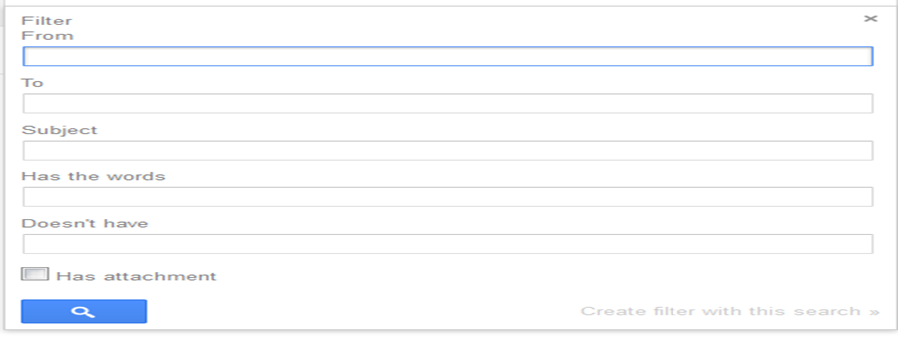
Creating a Filter, Part 1
Filters allow you to manage the flow of incoming email automatically. You can filter messages based on several criteria including who the message is from as well as words in the message or the subject. To create a filter:
. “
Tell the computer to search for certain messages by entering a search term in the box. For example, you could tell the computer to search for all of the messages with the word “food” in the them.
Click “Create filter” with this search and select the down arrow. For example, adding from “localdeals@amazon.com” in the from box would search for all messages from this address and with the word” food” in them.

Slide 9
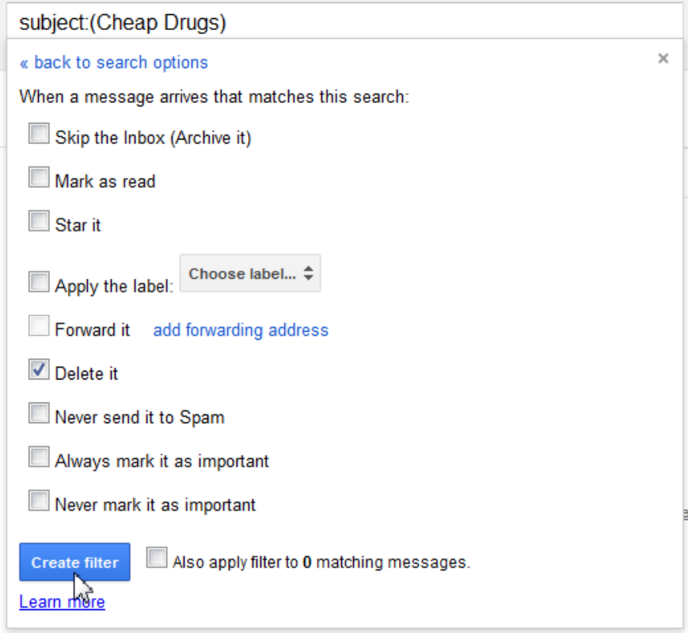
Decide what action you want the computer to take. (Delete, Label, Star, Forward, Mark as important) and click the “Create filter” link. If you want to automatically label your filters without looking at them, select “Skip the Inbox (Archive it)” and apply a label. You can then look at your messages at a later time.

Slide 10
More on Filters
When you create a filter to forward messages, only new messages will be affected. Any existing messages that the filter applies to will not be forwarded.
You can also create new filters from the manage labels page or settings tab.
Examples of some of my filters include: Delete all messages from localdeals@amazon.com; Send all messages from Facebook to the personal folder; Send any messages containing the words “new books” to the personal folder.

Slide 11
More on Filters
You can use an individual message to create a filter. Here is how:
Select the message in your Inbox
Click the More and “Filter messages like this” button at the top of the screen.
Enter your filter criteria in the appropriate field(s)
To edit or delete an existing filter:
Find the gear icon at the top right hand corner, and select “Settings” button
Click the Filters tab to find a list of current filters.
Find the filter you'd like to change; click and delete to remove the filter.
If you're editing the filter, click edit, enter the updated criteria for the filter in the appropriate fields, and click continue.
Update any actions and click the Update filter button.

Slide 12
Using Settings
Most email programs have a Settings page that will:
Notify you on your desktop when an important or priority message comes in. Turning these off may help you manage your Inbox more effectively.
Send an automated reply if your are on vacation or a contact sends you several messages.
Change how you forward messages
Many other things
To use settings in Gmail, click on Settings link on left side of page.

Slide 13
Other Tips
Use Contacts to create nicknames and groups for people to whom you often send email.
Send less email and be more precise in responding.
Reuse subject lines
Establish a routine
Review subject lines first because you may not have to read the whole message.

