Slide 1
Speeding Up Your PC
Roger Libman

Slide 2
Typical Repair Orders

Slide 3
Factors Causing Poor PC Performance
Hardware
Type and speed of processor
For Windows 7 and later, a multi-core processor is ideal
Amount of memory
2GB is a reasonable minimum
Slow hard drive
Drives vary in performance: 7200 RPM hard drive vs. 5400 RPM drive vs. SSD
Faulty drive
Hard drive close to full
WIFI Problems

Slide 4
Get to this screen with “Computer” icon (Windows 7)
or “This PC”
(later releases),
Right mouse click on icon and go to
“Properties”
Alternately, go to “System” in the Control Panel
Processor Type
Memory

Slide 5
Dealing with Hardware - Disk Drive Too Full
Check hard drive to make sure it is not close to full
Open “Computer” (Windows 7) or “This PC” (Windows 8 or 10). Look at “C” drive properties
If too full, consider
Deleting unnecessary (large) files
Moving files other storage
External hard drive
Cloud storage
Getting a larger hard drive (Your image will need to be copied.)
Running clean-up utilities to eliminate temporary files (More on this later)
Disk Cleanup – included in Windows
Ccleaner – a free 3rd party utility

Slide 6
Get to this screen by clicking “Computer” in Windows 7 or “This PC” in later releases
This disk has adequate space

Slide 7
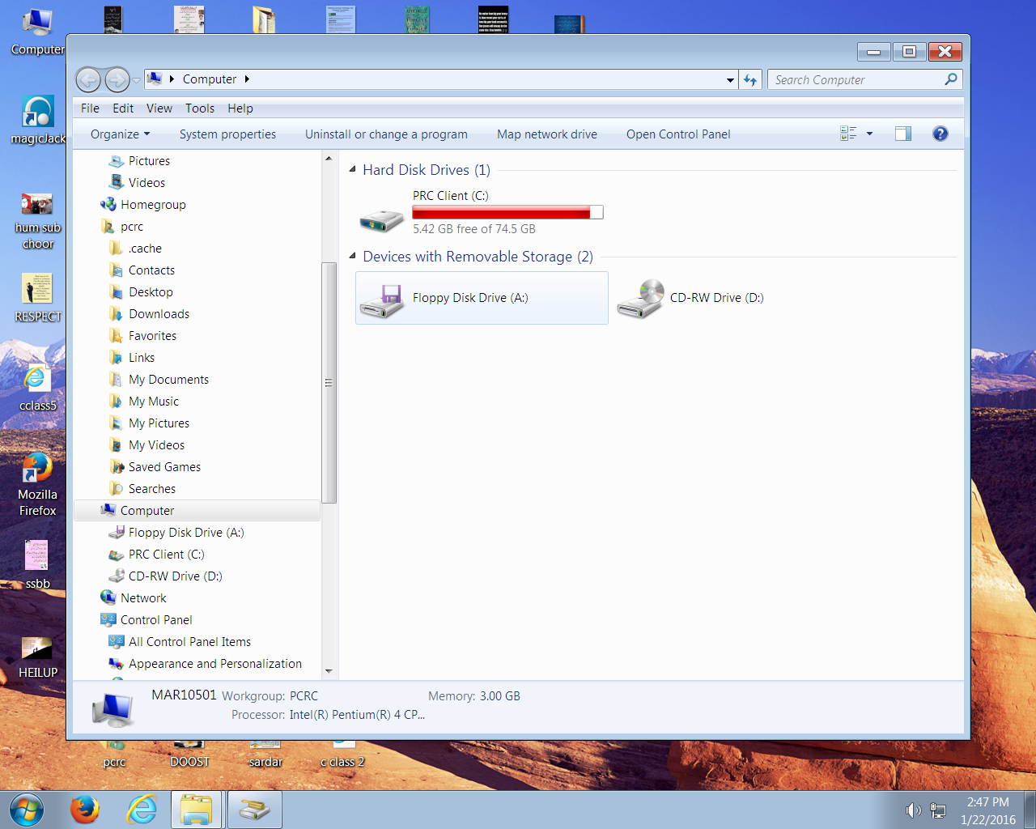
Get to this screen by clicking “Computer” in Windows 7 or “This PC” in later releases
This disk is too full

Slide 8
Causes of Slow PC
Software
Start-up items (programs which start when your computer is booted)
Accumulated temporary files
Rogue security / performance improvement programs
Registry Errors
Various types of malware (AKA junkware; spyware; adware)
Viruses
Windows performance degradation due to updates/service packs

Slide 9
Dealing with Software Issues
Start-up items
These are programs which start when the computer is booted. They occupy the computer’s memory. Too many such programs lead to very bad performance.
Run “msconfig” (Windows 7) or Task Manager (Windows 8 or 10).
Delete or turn off all unnecessary items and restart your computer. Note: Very few programs need to start when computer is booted. Virus protection is an exception. It should start.
Task Scheduler is another source of startup programs

Slide 10
Msconfig
In Windows 7, click the Start icon and type “msconfig” into the search box

Slide 11
Task Manager
In Windows 8 or Windows 10, right click in the task bar and select “Task Manager”
Click “Startup” tab
Right click on the status of a program and select “Disable”

Slide 12
Dealing with Software Issues
2. Accumulated Temporary files
Windows creates temporary files during normal operation and it doesn’t always do a good job of cleaning them up
As they accumulate over time they slow up your computer
Slow operation can be general or specific to web browsing
What can we do?
Run cleanup programs
Disk Cleanup (included in Windows)
Ccleaner (a free third party utility)
Initialize your web browsers (restore to factory condition)

Slide 13
Disk Cleanup
In Windows 7, find this program in the Start menu under Accessories/System Tools
In Windows 8 and Windows 10, it’s easiest to do a search for Disk Cleanup

Slide 14
CCleaner
Find this utility on the Internet
Needs to be installed
You can click “Analyze” and see what it finds and then click “Run” or just click “Run Cleaner”

Slide 15
Dealing with Software Issues
3. Rouge Security/Performance Improvement Programs
There are thousands of relatively useless programs which have names which make them sound useful (“Super Optimizer”, etc.)
These get installed unintentionally (sneaky install).
The utility “unchecky” can help prevent this from happening
You can often recognize these by the popups they cause. These can dominate your screen and interfere with proper operation of the PC.
What can we do?
Avoid getting rogue programs installed in the first place
Unfortunately, these must be manually uninstalled one by one.

Slide 17
Rogue Security / Performance Enhancing Programs – Example from an Actual Repair

Slide 18
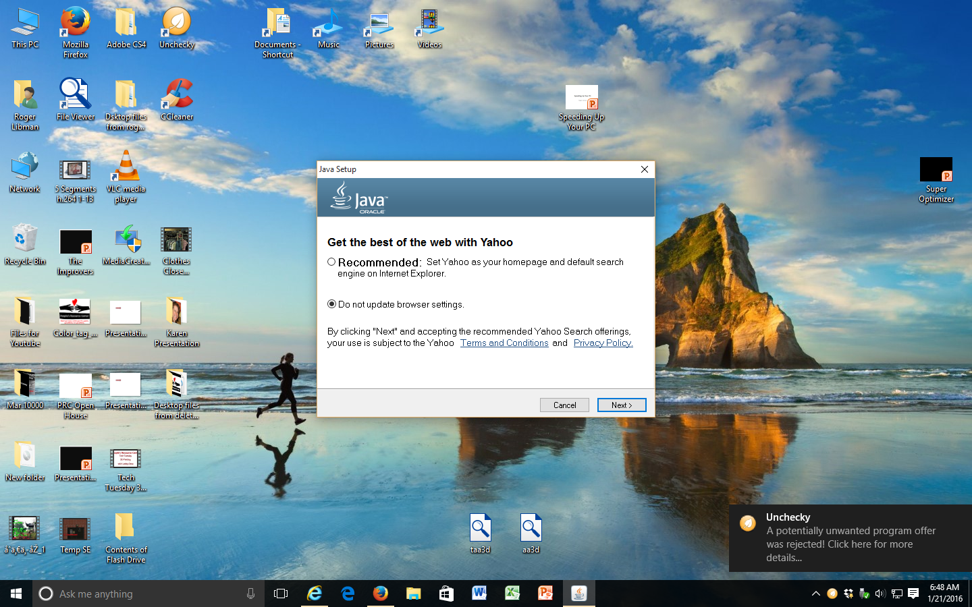
Example of Unchecky Preventing Unwanted Activity

Slide 19
Rogue Security / Performance Enhancing Programs - Uninstalling
Each program must be manually uninstalled
First, turn off unnecessary Start-up Items in msconfig and reboot
Booting in Safe Mode is best option (Windows 7)
Go to Control Panel
Click “Programs and Features”
Right click on the program to be uninstalled and select “Uninstall”
Be patient!
If uninstall fails, use the utility Revo Uninstaller

Slide 20
Dealing with Software Issues
4. Registry Errors
Definition - The Windows Registry is a hierarchical database that stores low-level settings for the Microsoft Windows operating system and for applications that opt to use the Registry
Over time, errors can accumulate in the registry which cause poor computer operation
Unfortunately, there are many rogue registry cleaners
This is a few very good, free registry cleaners. I recommend the Eusing Free Registry Cleaner.

Slide 21
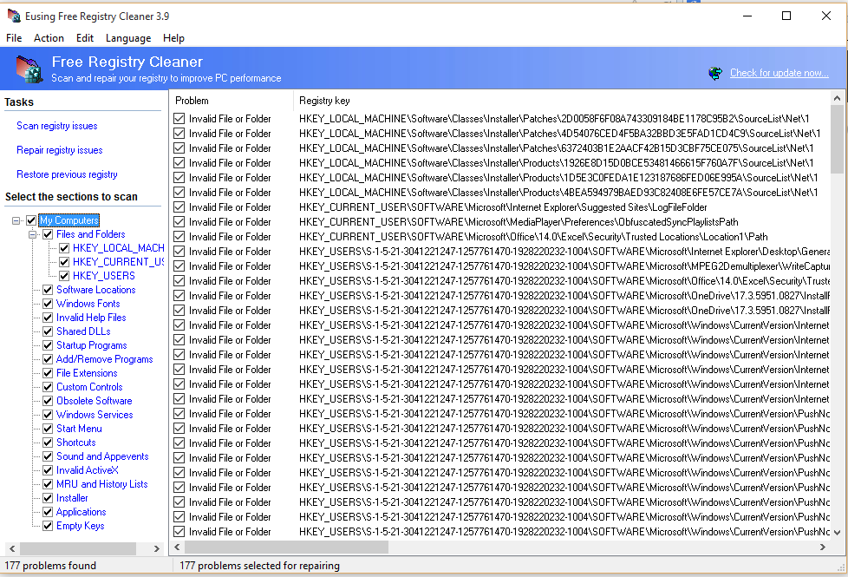
Eusing Registry Cleaner
Find this utility on the Internet
Needs to be installed
Click “Scan registry issues”
When scan is complete, click “Repair registry issues”
Make sure repair is complete before closing the program

Slide 22
Dealing with Software Issues
5. Various malware (AKA junkware; spyware; adware; worms). In general, these cannot be uninstalled like rogue security programs. So what can we do?
Run anti-malware programs
Lost in the chaos of rogue programs, there are a few good programs that help eliminate this stuff – and they’re free!
You need to know which programs are good – but you can’t tell by their names! Some suggestions are:
JRT (Junkware Removal Tool)
ART (Adware Removal Tool)
AdwCleaner (Adware Cleaner)
Malwarebytes
Spybot Search and Destroy
Super Antispyware
Note: The free versions of these programs must be updated and run manually

Slide 23
Dealing with Software Issues
5. Viruses
Definition: A computer virus is a program or piece of code that is loaded onto your computer without your knowledge and runs against your wishes. Viruses can also replicate themselves. A simple virus that can make a copy of itself over and over again is relatively easy to produce. Even such a simple virus is dangerous because it will quickly use all available memory and bring the system to a halt.
A virus can also perform any malicious activity that the writer intended
What can we do? In a word, prevention
Make sure your computer has the latest security updates
Make sure utilities such as Flash Player and Java are up to date
Be careful what you click on (email from unknown source, etc.)
Use a good antivirus program. Make sure it’s updated and runs scans regularly. Some recommendations:
Microsoft Security Essentials
Bitdefender
AVG
Avast
Make sure you have only 1 of these programs. They can get in each other’s way and cause bad computer performance

Slide 24
Dealing with Software Issues
6. Windows Updates and Service Packs
Unfortunately, these are unavoidable. They are necessary to help keep your computer free of malware
Every properly functioning Windows computer gets new updates regularly
While they do impact performance, having adequate hardware (the appropriate processor, enough memory, hard drive which is not too full) makes the tradeoff reasonable

Slide 25
Finally
Sometimes we do everything described in this talk (and more) and we fail to get the desired performance.
What can we do?
Start over. Load a fresh copy of the Windows operating system
Some experts recommend doing this every year or two as standard practice
Need to deal with personal files (text files, music, pictures) as well as programs that did not come with the computer and were installed later

Slide 26
Where to Get Utilities Described in this Talk
Using Registry Cleaner http://www.eusing.com/Download.htm
JRT (Junkware Removal Tool) http://www.bleepingcomputer.com/download/junkware-removal-tool/
ART (Adware Removal Tool) http://www.techsupportall.com/adware-removal-tool/
AwdCleaner http://www.bleepingcomputer.com/download/adwcleaner/
Malwarebytes https://ninite.com/
Spybot Search and Destroy https://ninite.com/
Super Antispyware https://ninite.com/
Microsoft Security Essentials https://ninite.com/
Bit Defender http://www.bitdefender.com/solutions/free.html
AVG https://ninite.com/
Avast https://ninite.com/
Revo Unstaller https://ninite.com/
Unchecky http://unchecky.com/

Slide 27
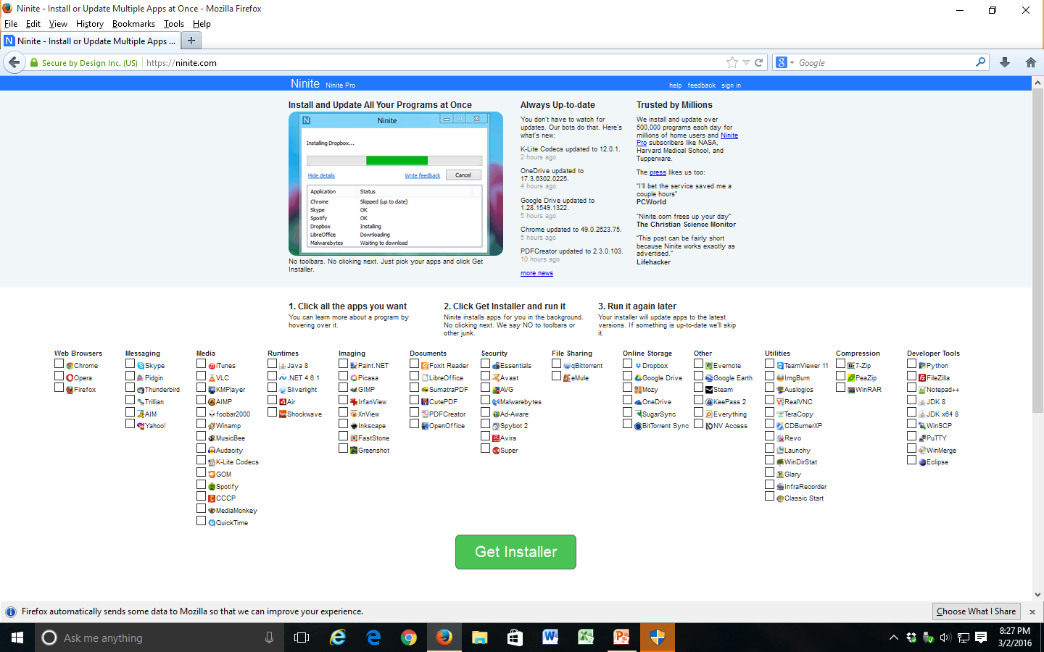
The ninite.com Web Page

Slide 28
Supplement

Slide 29
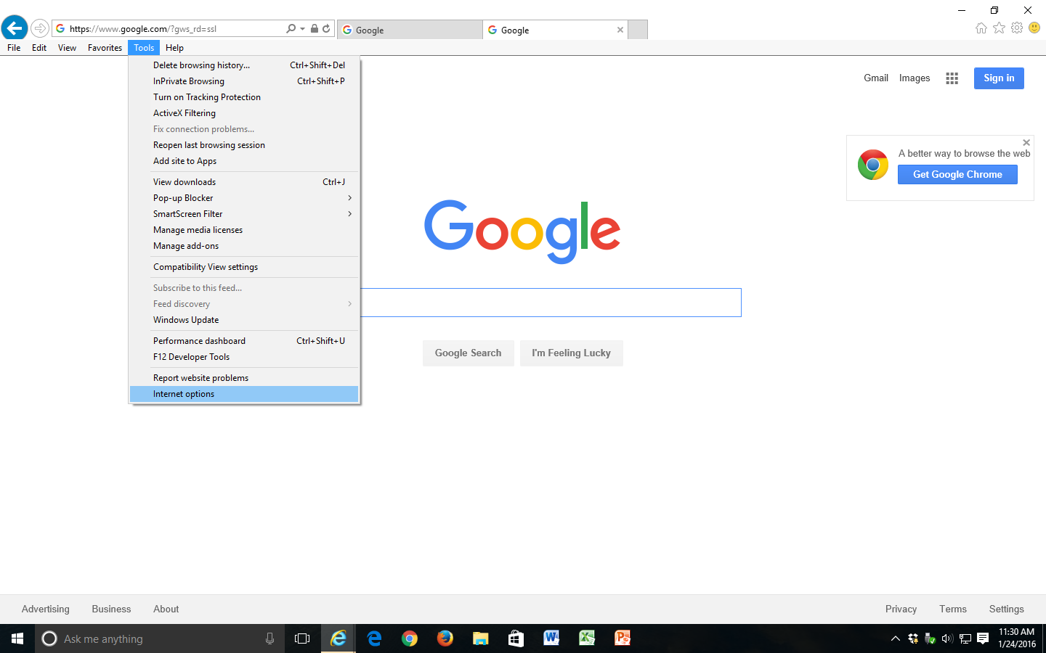
Initializing Internet Explorer

Slide 30
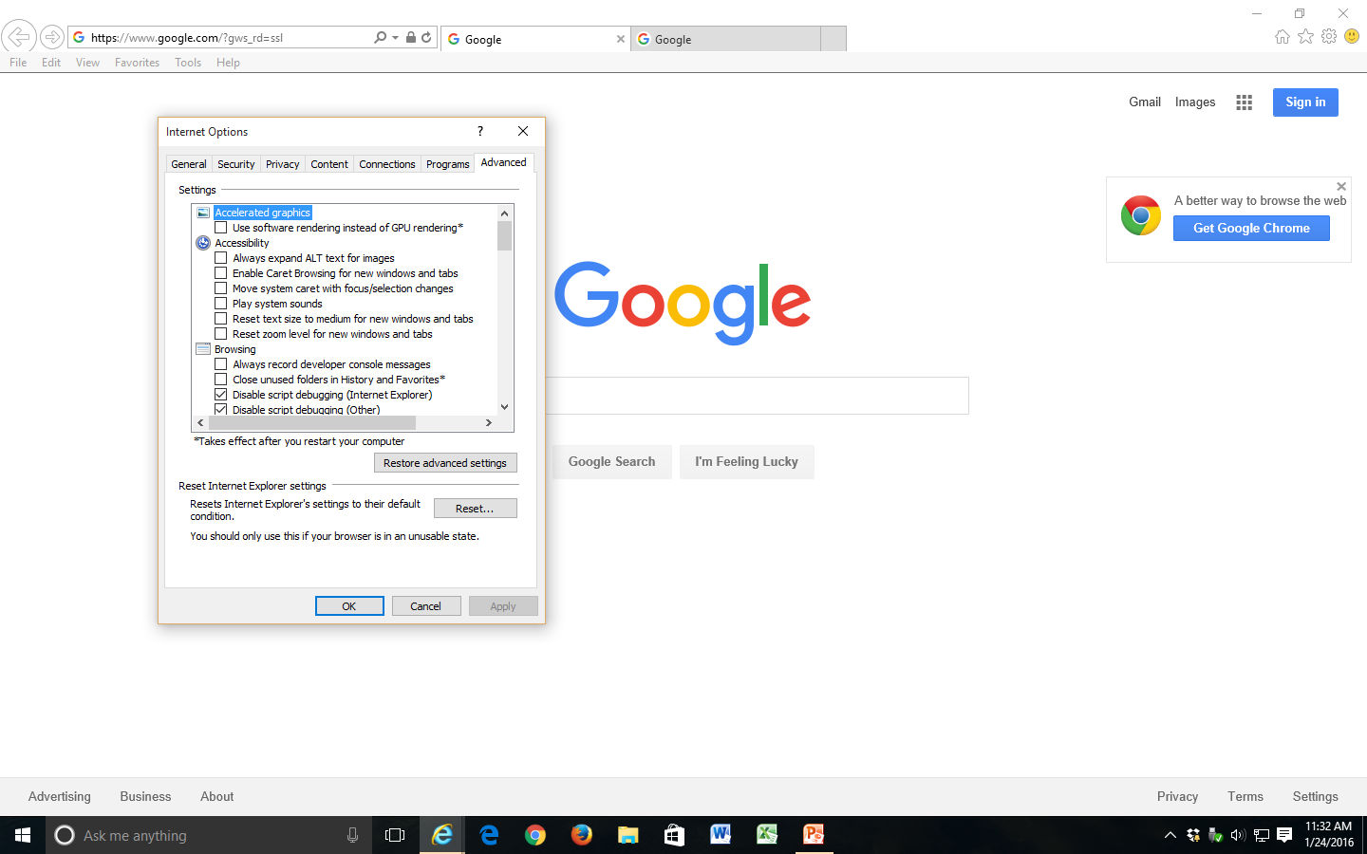
Resetting Internet Explorer – cont.
Go to Advanced tab
1
2

Slide 31
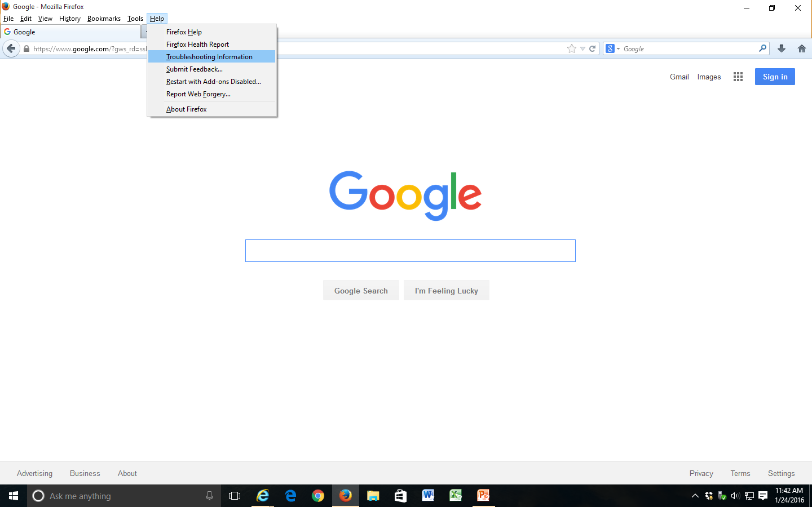
Resetting Firefox

Slide 32
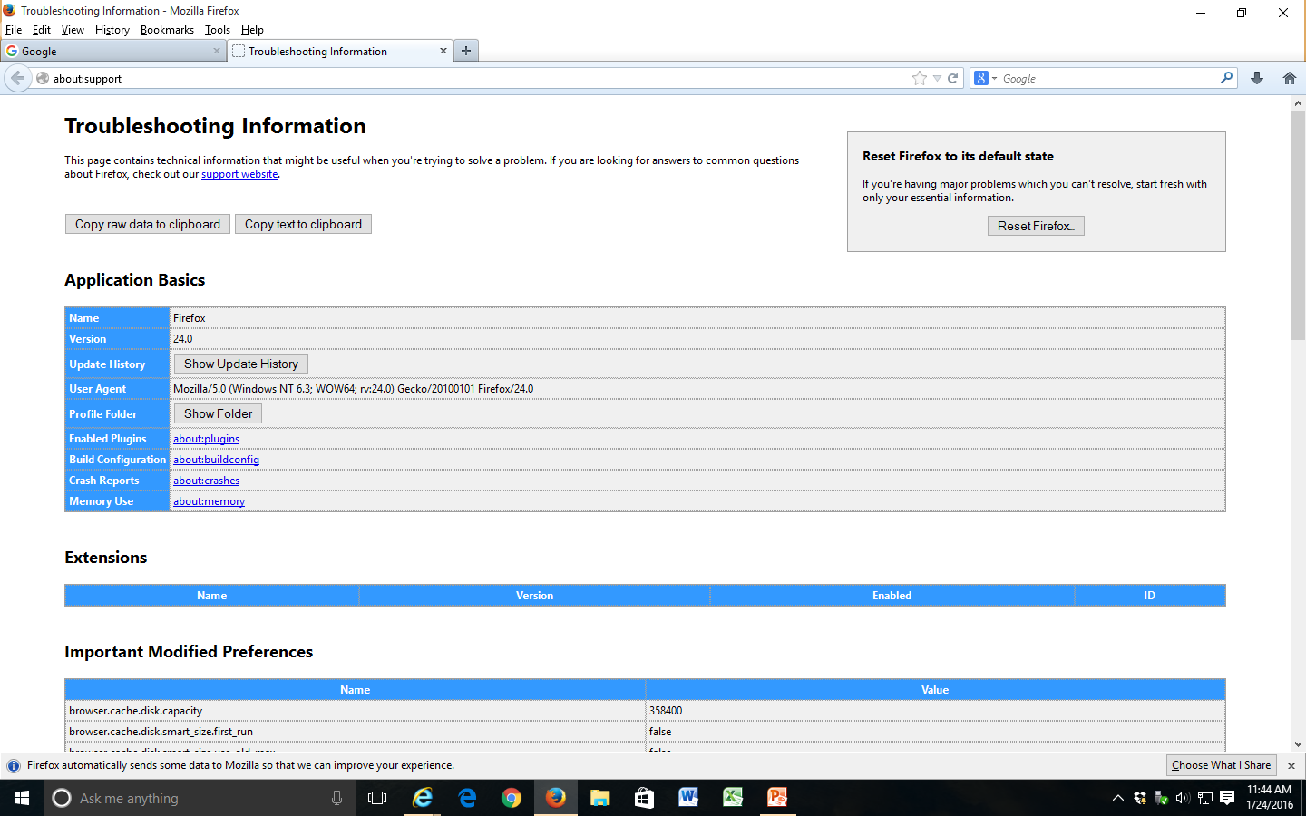
Resetting Firefox cont.

Slide 33
Resetting Google Chrome

Slide 34
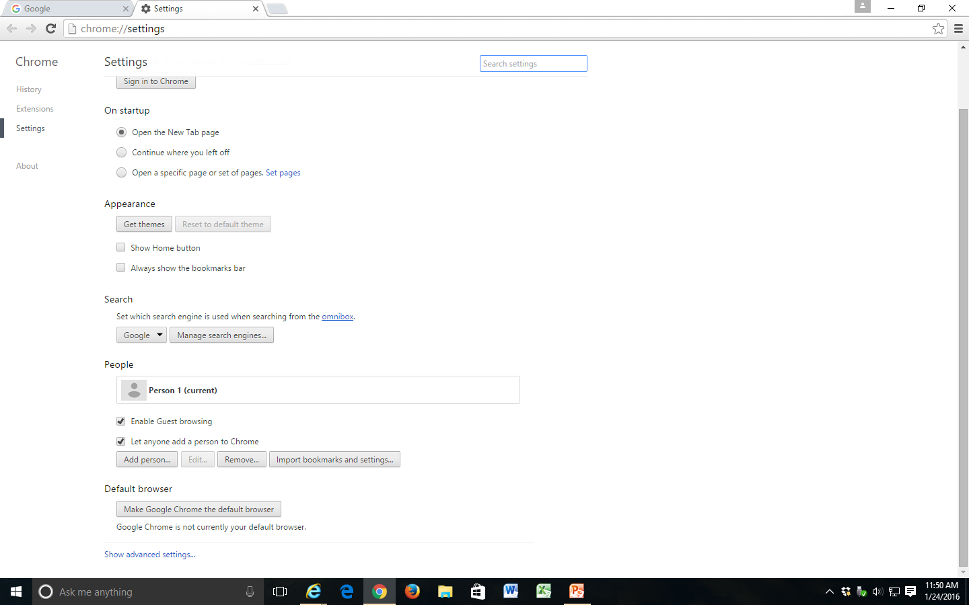
Resetting Google Chrome cont.
Scroll to bottom and click “Show advanced settings”

Slide 35
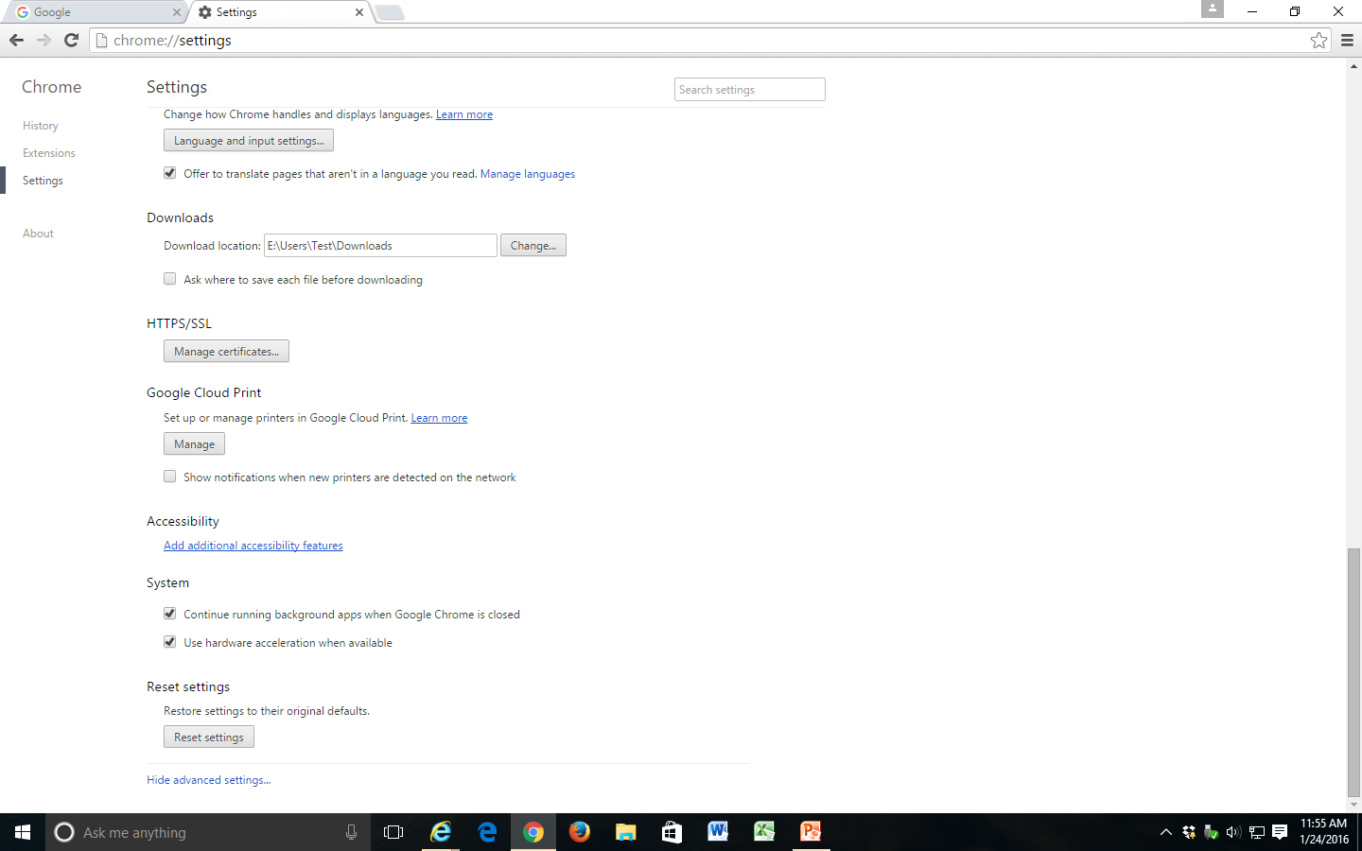
Resetting Google Chrome (cont.)
Scroll to the bottom again and click “Reset settings”

