Slide 1
PowerPoint 1 – Course Overview
A seven week course to learn how to effectively use MS PowerPoint.
Week | Topic | Covering….
1 | Class approach & Basics | Course outline, Google Drive, PowerPoint Interface, Themes, & Text
2 | Clip Art and Tables | Exercises, Student Project. Homework Assignment
3 | Using Graphics | Exercises, Revise Student Project, Homework Assignment
4 | Using Charts and Media Clips | Chart Creation, Insert Sound, Slide Header & Footer, Slide Master, Student Project, Homework
5 | Slide Show Design | Word Art, Including Objects, Slide Design, Transitions, Homework, Student Project Update.
6 | Animation | Slide sorter, Adding animation, Using Slide Sorter, Presenter notes, Student Project, Homework
7 | Student Project Presentations | Presentation of Student Projects
Steve Jackson (630) 750-1233 Christopher Culp
steven_w_jackson@prodigy.net

Slide 2
Student and PRC Participation
Student Responsibilities:
Attend every class or notify of an absence in advance.
Participate in the discussion, complete the exercises and homework, develop a student project.
Create a google e-mail account use learn Google Drive.
Complete the Homework assignments.
PRC Services
Provide an Internet-capable PC after 1st class (Internet service connection not included).
Access to Instructors and Tutors available at several PRC sites.
Prepare the student to design and create a presentation.
Introduce cloud-based shared service, Google Drive.

Slide 3
Week 1 – Using the PC File System
Libraries
Desktop
Pictures
C:
Documents
Music
student
My Pictures
My Documents
My Music
PowerPoint 1
Week 1
Week 2
Week 3
Week 4
Week 5
Week 6

Slide 4
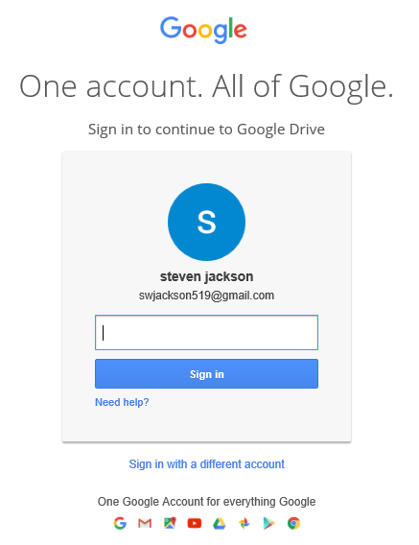
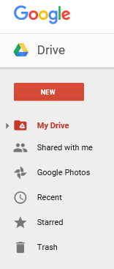
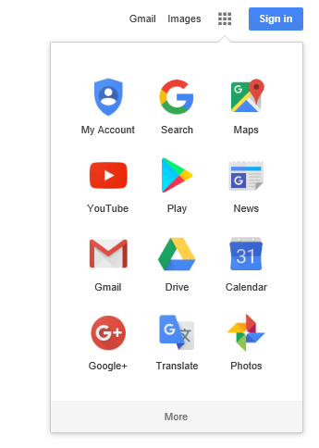
Week 1 – Accessing Google Drive
Step 1: Sign In
Step 2: Open Drive
Step 3: Select Folder
(www.google.com)
Display Folders
Click Here
Enter Password

Slide 5
Week 1 – PowerPoint Class Folder
Contents of the PowerPoint Folder
Weekly Folders
Google Drive PPT
Google Drive Instructions
Class Survey
Student Presentation Outline

Slide 6
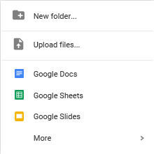
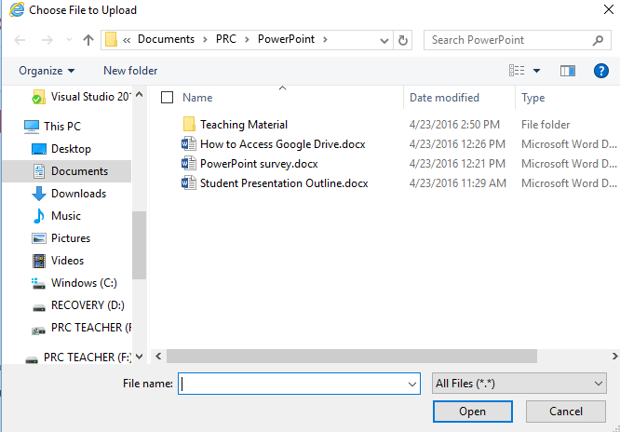
Week 1 – Upload a File
Step 1: Open the Menu
Step 2: Choose a file to upload
Choose Option

Slide 7
Week 2 – Student Presentation Outline
Student Presentation Outline Format
Title: _______________________________________
Page | Topic | Contents | Special Effect
1 | Title
 | Conclusion
What do you want the audience to remember?
Why are you presenting the information?
What actions do you want the audience to take?
Confirm that you got your story across.

Slide 8
Week 2 – Student Presentation Outline
Presentation Outline (example)
Title: Who wants to buy my car?
Page | Topic | Contents | Special Effect
1 | Title | Introduce Car make and model | none
2 | Body | Summary of car’s features | bulllets
3 | Body | Repair History highlights | Table
4 | Body | Car ranking among similar makes & models | Pictures
5 | Body | Maintenance history and current condition | Charts
6 | Body | Summary of why this car is a good value | Animation
7 | Conclusion | Main reasons to buy this car | Animation & Sounds

