Slide 1
Is it time to cut the cable?
How to decide and how to do it...

Slide 2
Who am I?
Emerging Technology Librarian Cook Memorial Public Library District ngass@cooklib.org Twitter: @natesbroadcast
Technology Instructor
Longtime cord-cutter (2007-present)
Nate Gass

Slide 3
What will we cover?
What is cord-cutting?
Is it right for you?
Content
Equipment

Slide 4
What is Cord-Cutting?
Cord Cutting- when “consumers jettison traditional cable and satellite packages in favor of streaming services.” NBC News
What are streaming services? Streaming- the media downloads while it's playing so you don't have to wait for it to download first. gcflearnfree.org

Slide 5
Using the Internet to watch TV. On demand and a la carte.
Notice I didn’t say free.

Slide 6
What do I need?
High Speed Internet
Streaming device
Access to online video content
HD Antenna (optional)

Slide 7
Is my Internet fast enough?
Recommended speeds for streaming video… -according to Netflix
1 Mb/s for viewing on a laptop computer
2 Mb/s for viewing standard definition video on a TV
4 Mb/s for viewing High Definition video
5 Mb/s or more for the best audio and video experience
Check your speed at www.speedtest.net

Slide 8
Costs and Considerations
How much do you pay for television now? Average cost of cable in 2014 was $64..41 per month. (Federal Communications Commission 2014)
How much do you pay for Internet now?
What do you actually watch?
Would you be happy with current streaming options? http://www.justwatch.com/
Notes:
Talk about bundling.

Slide 9
How do you calculate the cost to cut the cable?
Internet access + HD Antenna + Access device(s) + Monthly & Annual Subscriptions = $TOTAL COST$
The Verge’s Cord-Cutting Calculator

Slide 10
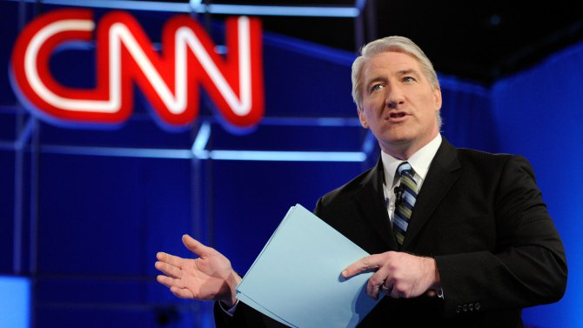
What do you actually watch on TV?
Time’s Streaming Packages

Slide 11
2 quick disclaimers before proceeding...
This is an informational presentation on streaming content and equipment currently on the market. No endorsements or recommendations are intended. In other words- I’m not paid by any company and I’m not selling you anything.
This stuff changes daily….maybe even hourly.

Slide 12
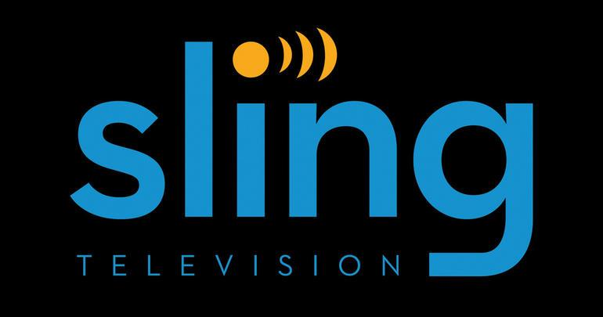
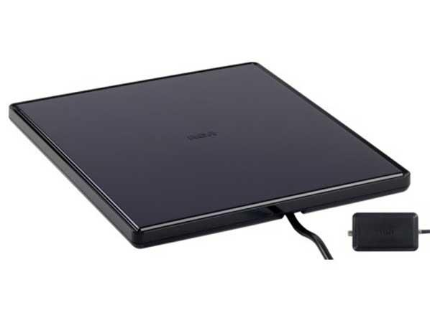
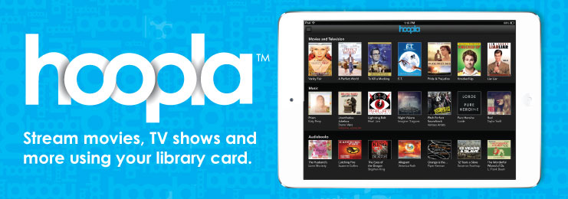
The Content

Slide 13
HD Antenna*
HD Quality!
Good antenna will get major networks (FOX, ABC, NBC, CBS?, and PBS)
Local programming
Get your channel surfing fix
You’ll be surprised how many OTA channels are out there.
Price: Content = FREE! / Device = $15-$100
*DVR options available through services like Tablo.

Slide 14
Thousands of movies, documentaries, and TV shows
Great selection of kids content
No commercials
Original programming including House of Cards, Orange is the New Black, and Marvel’s Jessica Jones
Cons: Catalog selection can change due to licensing and TV shows aren’t current
30 day free trial, Basic $7.99 - Standard $9.99 - Premium $11.99 plans

Slide 15
Current and past programming from TV networks including: ABC, NBC, FOX ABCFamily, Comedy Central, FX CW, History/H2, HGTV
Movies (including the Criterion Collection)
Some original programming
30 day free trial, $7.99 w/ commercials, $11.99 commercial-free
Additional content from Showtime for an additional $8.99 per month

Slide 16
Amazon Prime membership goes beyond streaming video content (free 2-day shipping, Prime Music, Prime Photos, Kindle lending library)
Thousands of movies and TV shows available to stream instantly, at no additional cost, including older HBO shows like The Sopranos and The Wire
Some original programming- Transparent
30 day free trial, $99.00 per year
Amazon also offers TV passes for current shows. Pay-per-episode for current seasons.

Slide 17
Access current seasons of HBO shows such as Game of Thrones, True Detective, and Veep
Includes movies, documentaries, and HBO comedy specials.
Available on all popular streaming devices.
30 day free trial, $14.99 per month.

Slide 18
Stream live TV! No long-term contracts, installation, or cancellation fees.
Subsidiary of Dish Network, but Dish subscription is not necessary.
Networks include ESPN, ESPN2, AMC, TNT, TBS, CNN, History, Food Network, HGTV, Cartoon Network, Disney Channel, ABC Family, IFC, Galavision, and more
“Best of Live TV,” $20.00 per month, add-ons for additional $5.00 per month- see CNET review.
Not available on every streaming device (notably no Apple TV support).
Commercials
Notes:
Right now seems like best option for sports.

Slide 19
Full length movies, TV shows, and original programming
Free
Limited commercials
Compatible with all devices

Slide 20
Rent or purchase movies - the cord-cutters’ Blockbuster
Store digital copies of physical DVDs/Blu-rays you purchase
Price: pay-per-view

Slide 21
“The under-appreciated cord-cutting tool” - Cord Cutters News
Free online videos
Great for short clips or buzzworthy/viral bits (when you need a good laugh)
Major channels (HBO) often release free episodes on YouTube
Channel apps available for many streaming devices
Ads in videos

Slide 22
The library’s streaming solution!
Thousands of movies, TV shows, and even music albums available to check out and stream for free!!
Check out up to 8 titles per month.
**NEW** Chromecast support!
Note: hoopla does not currently offer channel apps for television streaming devices (Roku, Apple TV, etc.)

Slide 23
Miscellaneous
Notes:
Talk about purchasing individual content and TV show passes through Amazon.

Slide 24
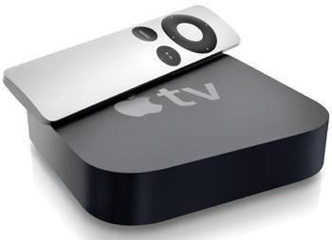
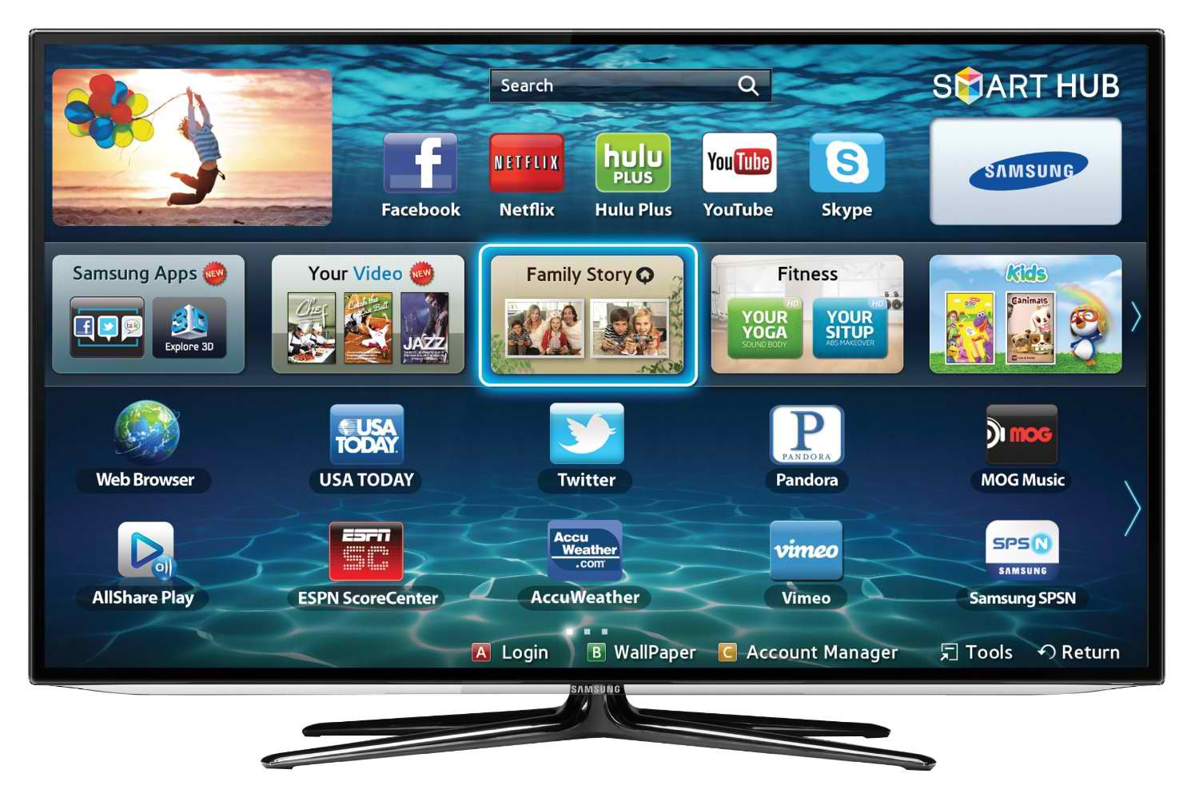
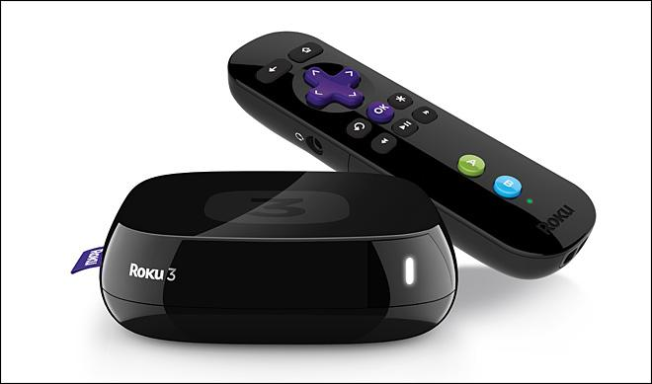
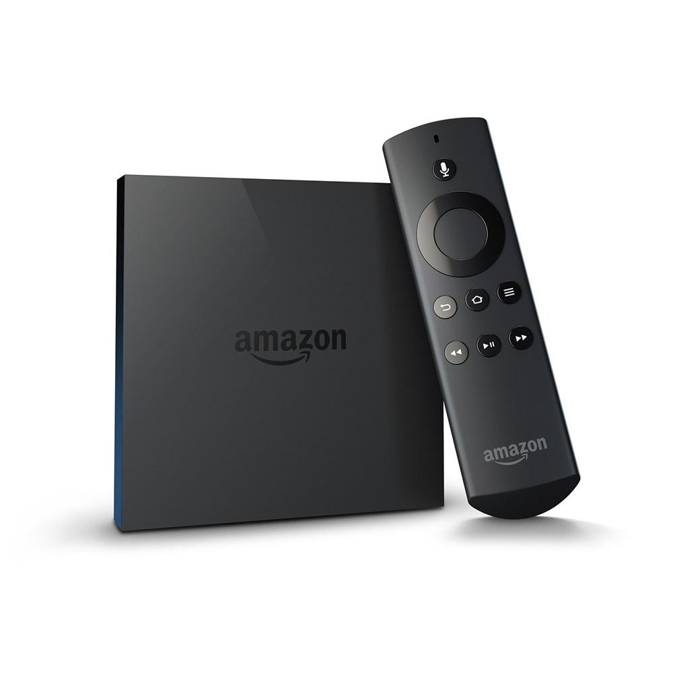
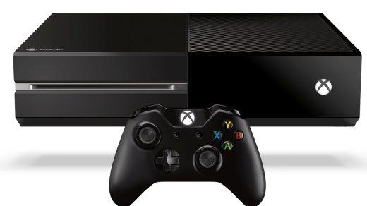
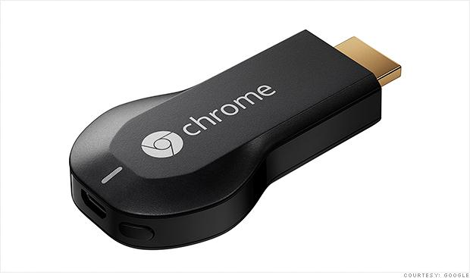
The Equipment

Slide 25
A quick word of advice...
Decide what content you want BEFORE purchasing a streaming device. Investigate not only the device’s features, but its compatibility with channels and content you want.

Slide 26
Apple TV
Price: $69.00 (3rd generation) $149 (4th generation)
Connects via HDMI input
Add apps to view content (example: Netflix, Hulu, HBO, PBS, etc.)
No Amazon Prime App – Buy episodes from the iTunes store or use Airplay
No Sling TV
AirPlay – Mirrors whatever is on your Apple device to the big screen

Slide 27
Roku
Prices range from $49.99 to $129.99
Built for streaming content on television
Access to 2,500+ channel/content apps.
Not tied into any larger tech company’s ecosystem. Content agnostic.
Search feature lets you search all channels simultaneously.
Remote on some models includes headphones for quiet listening.

Slide 28
Amazon Fire TV
Price: $39.99 - $99.00 - $139.99 options
Connect to Amazon account then add channels
Outputs 4K video
Optional controller package for gaming
voice remote search system

Slide 29
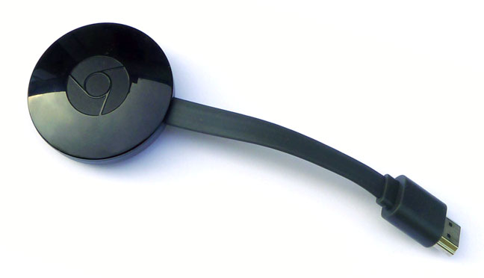
Google’s Chromecast
Price: $35.00
No on-screen interface or remote control
Use mobile and web apps that support Google Cast to select programming (no remote)
Content can be mirrored from the Chrome browser on computer for Android devices.

Slide 30
Video Game Console, Smart TV, or Blu-ray Player
Televisions, players, and gaming consoles that are Wi-Fi enabled and feature the ability to add popular streaming apps.
Price: depends
Sometimes channels are not supported, lag behind in updates, or lack key features.
Don’t forget about laptops, computers, and phones! You’ve probably cut the cord in some ways already.

Slide 31
Don’t forget the library!
Your library card can be a powerful cord-cutting tool.
Binge watch past seasons of the most popular television shows on DVD.
Extensive Blu-ray and DVD collection- a diverse film vault at your fingertips. (get on our mailing list for feature films coming soon)
Weekly free Movie Matinee showings
Stream movies and TV w/ hoopla!
Notes:
Add that our DVD collection includes some original content from streaming platforms like House of Cards

Slide 32
Questions? Comments?

