Slide 1
PEOPLE’S RESOURCE CENTER
TECH TUESDAY: TWITTER FOR BEGINNERS
10-20-2015

Slide 4
What Is Twitter? What Is 'Tweeting'?
Twitter is microblogging. Twitter, and 'tweeting', is about broadcasting daily short burst messages to the world, with the hope that your messages are useful to others.
Conversely, Twitter is about discovering interesting people online, and following their burst messages for as long as they are interesting.

Slide 5
Why Is Twitter Used?
News
Entertainment
Trending Topics in World/Pop Culture
Sales Leads & Business (Twitter Ads)

Slide 6
Why Is Twitter So Popular?
Why Do People Follow Other Tweeters? Twitter's big appeal is how rapid and scan-friendly it is: you can track hundreds of interesting tweeters, and read their content with a glance.

Slide 7
Are there Restrictions to My Tweets?
Twitter employs a purposeful message size restriction to keep things scan-friendly: every microblog 'tweet' entry is limited to 140 characters or less. This size cap promotes focused and clever use of language, which makes tweets very easy to scan, and also very challenging to write well.

Slide 8
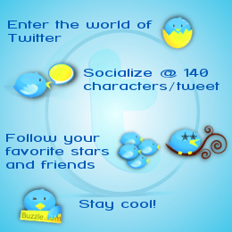
How Does Twitter Work?
Twitter is simple to use as broadcaster or receiver.
Twitter accounts are free.
You can send broadcasts daily, or as you wish, in 140 characters or less.
To receive Twitter feeds, you simply find someone interesting (celebrities included), and 'follow' them to subscribe to their tweet microblogs.
Once a person becomes uninteresting to you, you simply 'unfollow' them.
You then choose to read your daily Twitter feeds through any of various Twitter readers.

Slide 10
Definitions
@ – The symbol for identifying a person that you are calling out in a tweet. Similar to a tag in Facebook.
# - The symbol used to tie data together on one particular subject area.
Direct Message: A message between you and another follower of yours on Twitter.
Favorite: Thumbs up for someone’s Tweet. Similar to a thumbs up on Facebook or Youtube.
Feed: The area in which you will see Tweets for the people/places you follow.
Follow: A person or business you would like to connect with.
Follower: Someone who wishes to or is connected with you.
Retweet: Sharing someone else’s tweet as if it was your own.
Tweet: A public message to the world in 140 characters or less.

Slide 11
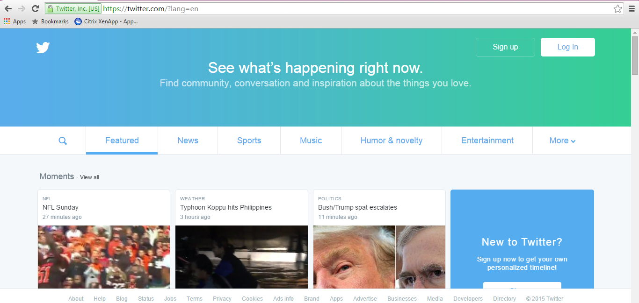
STEP 1: LOG ONTO TWITTER.COM
STEP 2: CLICK SIGN UP BUTTON (YOU WILL NEED AN ACTIVE EMAIL TO JOIN)

Slide 12
STEP 3: ENTER IN YOUR FIRST AND LAST NAME, TELEPHONE/EMAIL, AND A PASSWORD
STEP 4: TAILOR TWITTER – YOUR CHOICE
STEP 5: CLICK SIGN UP

Slide 13
STEP 6: ENTER YOUR CELL PHONE NUMBER, THIS ALLOWS FOR A TWITTER ACCOUNT VERIFICATION TO BE SENT TO YOUR CELL PHONE
STEP 7: CLICK NEXT

Slide 14
STEP 8: CHECK YOUR CELL PHONE FOR YOUR UNIQUE VERIFICATION CODE
STEP 9: ENTER THE VERIFICATION CODE AND CLICK VERIFY

Slide 15
STEP 10: SELECT A USERNAME & CLICK NEXT

Slide 16
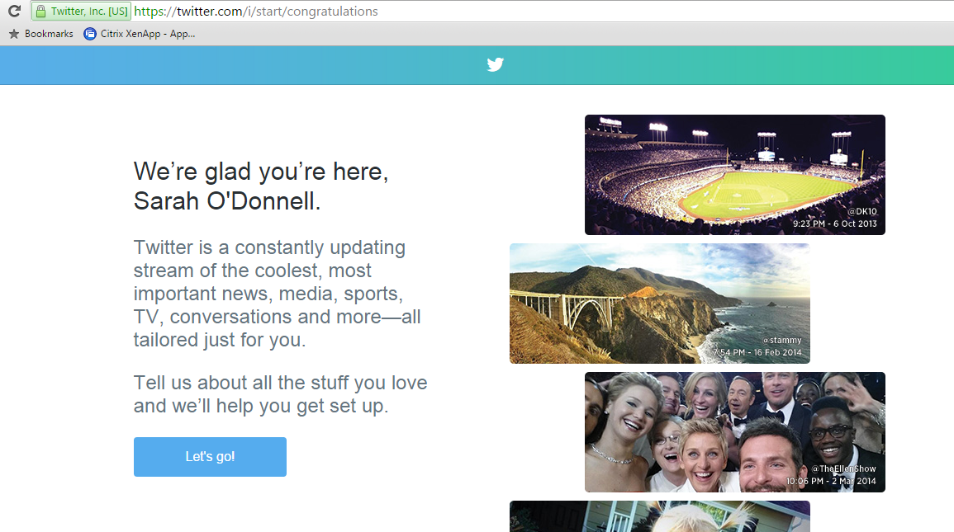
STEP 11: CLICK LET’S GO

Slide 17
STEP 12: ENTER YOUR INTERESTS (THIS WILL HELP FOR DETERMINING WHAT TYPE OF TWEETS YOU WILL SEE IN YOUR FEED)

Slide 18
STEP 13: REVIEW THE SUGGESTIONS OF PEOPLE/PLACES YOU SHOULD FOLLOW BASED ON YOUR INTERESTS AND DEMOGRAPHIC INFORMATION THAT WAS PREVIOUSLY ENTERED.
YOU CAN SELECT ALL OR IDENTIFY ONLY THOSE THAT INTEREST YOU.
CLICK FOLLOW & CONTINUE

Slide 19
STEP 14: UPLOAD YOUR PHOTO
IF YOU ARE AT HOME, YOU CAN SELECT A PHOTO FROM YOUR SAVED FILES, OTHERWISE, YOU CAN FOLLOW ALONG FOR PICKING A PHOTO FROM GOOGLE.COM.
CLICK CONTINUE

Slide 20
STEP 14: UPLOAD YOUR PHOTO
IF YOU ARE AT HOME, YOU CAN SELECT A PHOTO FROM YOUR SAVED FILES, OTHERWISE, YOU CAN FOLLOW ALONG FOR PICKING A PHOTO FROM GOOGLE.COM.
CLICK CONTINUE

Slide 21
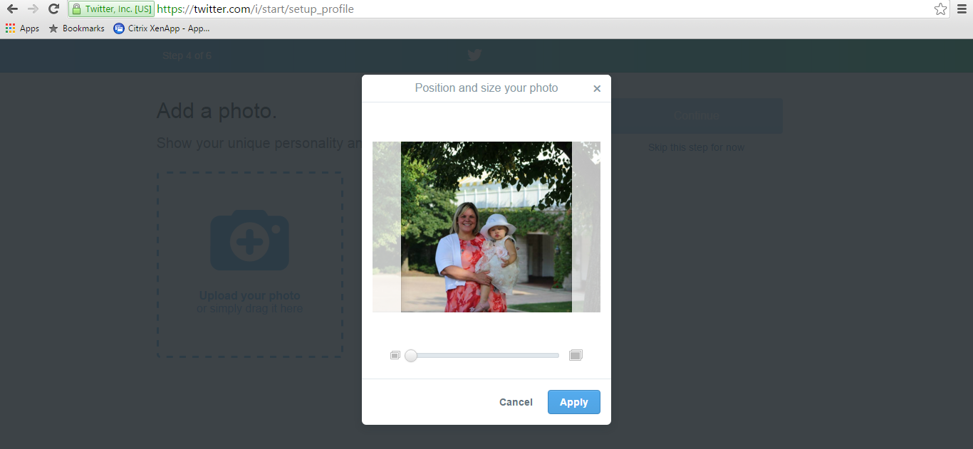
STEP 14: UPLOAD YOUR PHOTO
ON THIS PARTICULAR PAGE YOU CAN POSITION AND SIZE YOUR ACCOUNT PHOTO AND THEN CLICK APPLY.

Slide 22
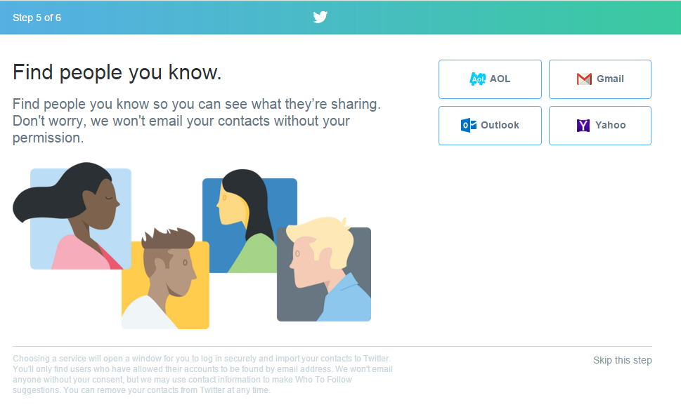
STEP 15: YOU MIGHT HAVE FRIENDS THAT ARE ALREADY ON TWITTER, YOU CAN FIND OUT BY CLICKING ON YOUR EMAIL PROVIDER AND LOADING IN YOUR CONTACTS FROM THE PROVIDERS THAT ARE LISTED.
THIS STEP CAN ALSO BE SKIPPED (SEE LOWER RIGHT).

Slide 23
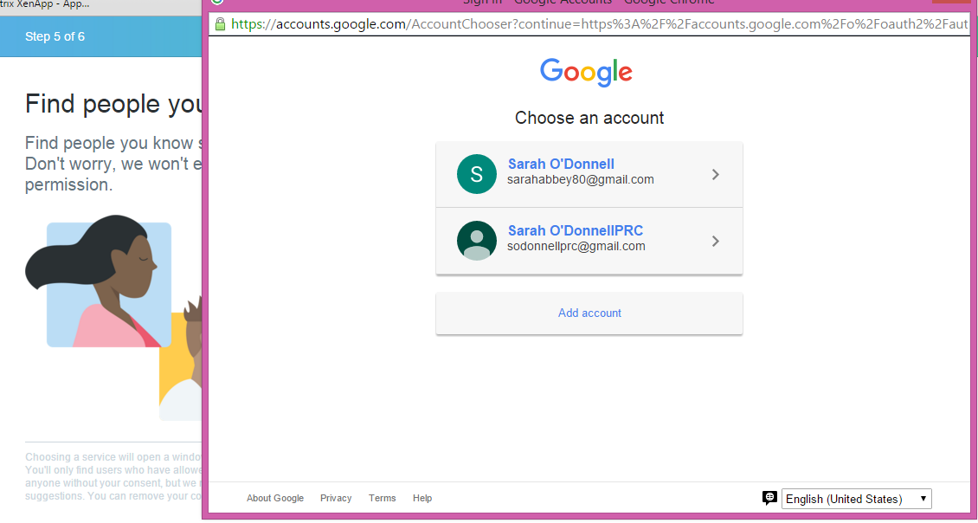
STEP 15: I DECIDED TO CONNECT MY GOOGLE ACCOUNT.

Slide 24
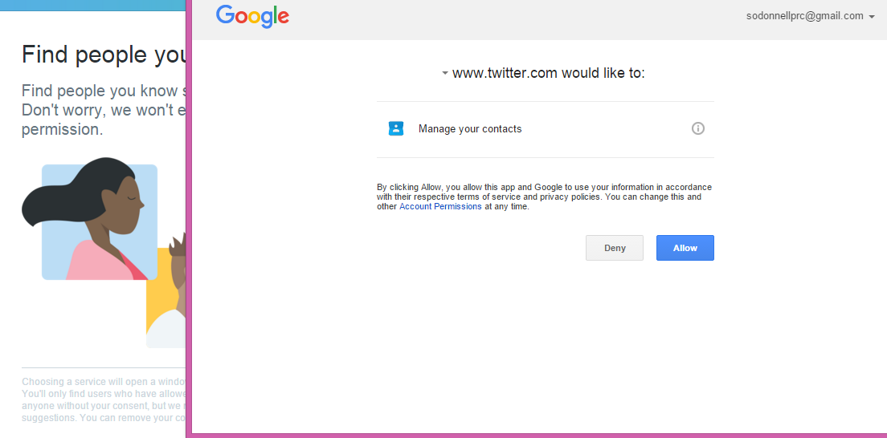
STEP 15: I DECIDED TO CONNECT MY GOOGLE ACCOUNT.

Slide 25
STEP 16: BASED ON YOUR CONTACT IMPORTS FROM YOUR EMAIL PROVIDER, YOU MAY BE PROMPTED TO SELECT MORE PEOPLE/PLACES TO FOLLOW.

Slide 26
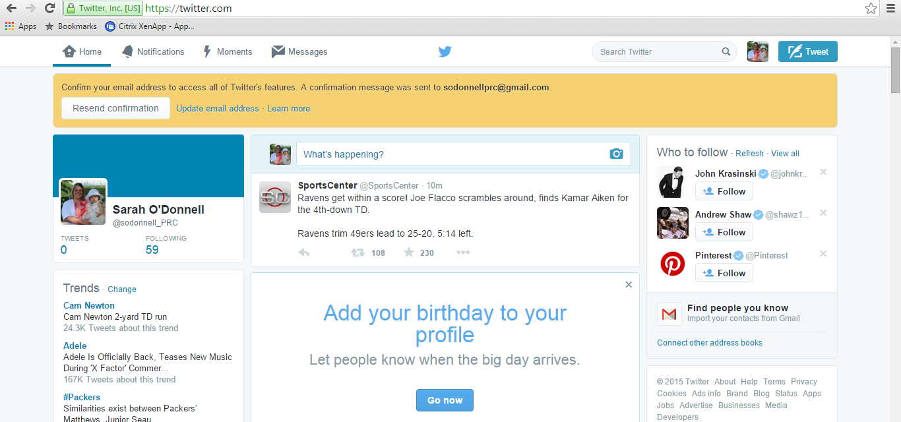
STEP 16: YOUR HOME SCREEN & CONFIRMING YOUR EMAIL

Slide 27
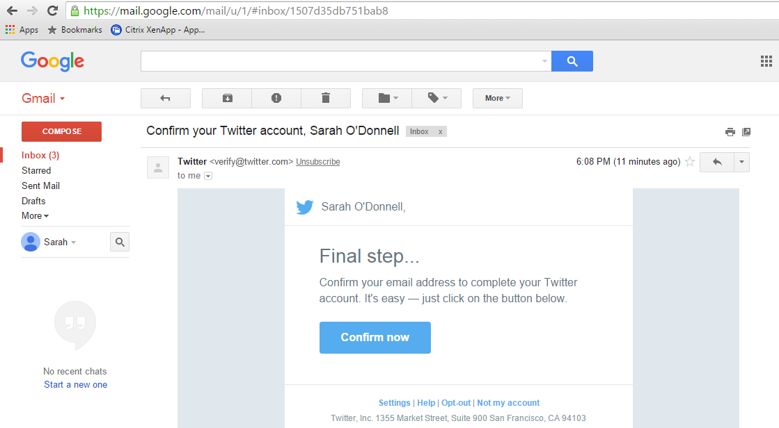
STEP 17: VISIT YOUR EMAIL PROVIDER AND CONFIRM YOUR TWITTER ACCOUNT

Slide 28
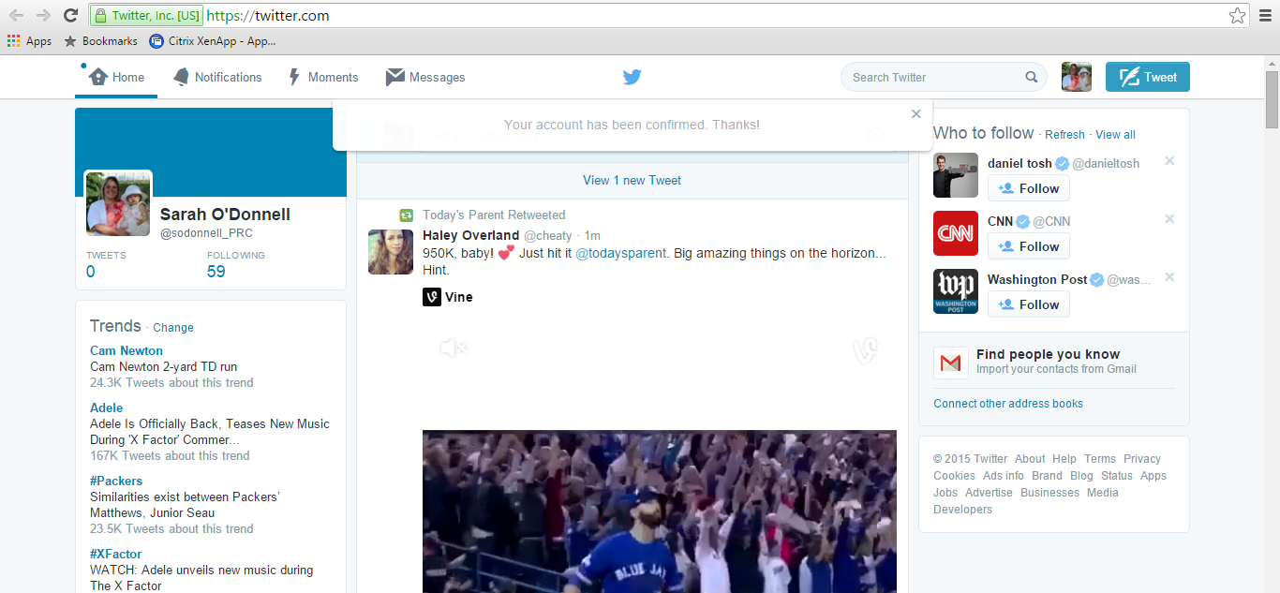
STEP 18: ACCOUNT CONFIRMED & NAVIGATING YOUR HOME PAGE

Slide 29
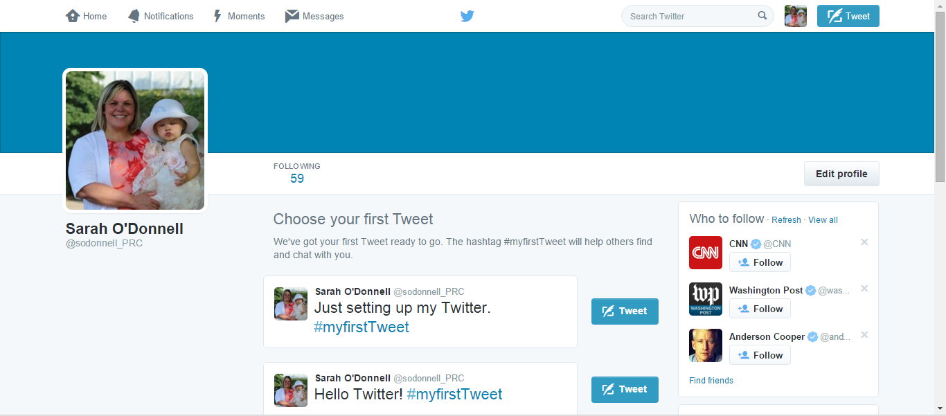
STEP 19: EDIT YOUR PROFILE

Slide 30
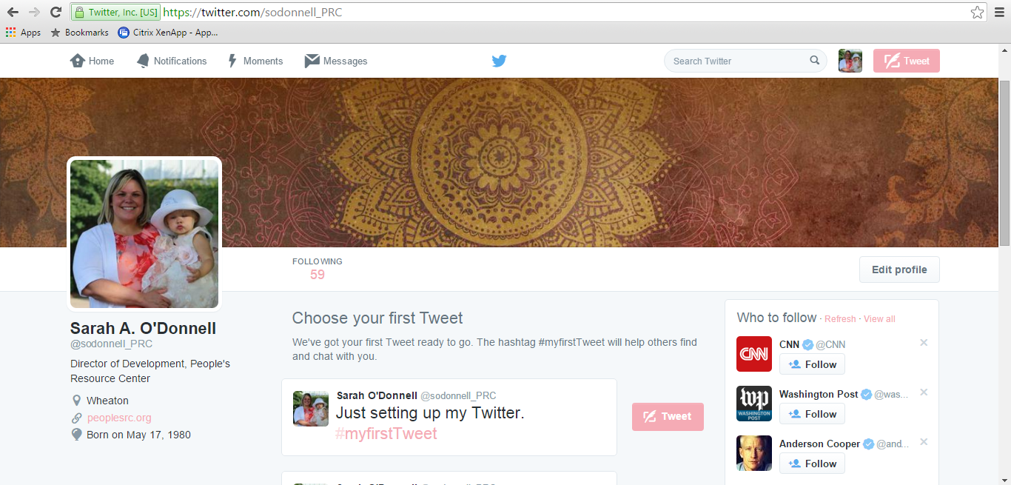
STEP 20: ADD A BANNER

Slide 31
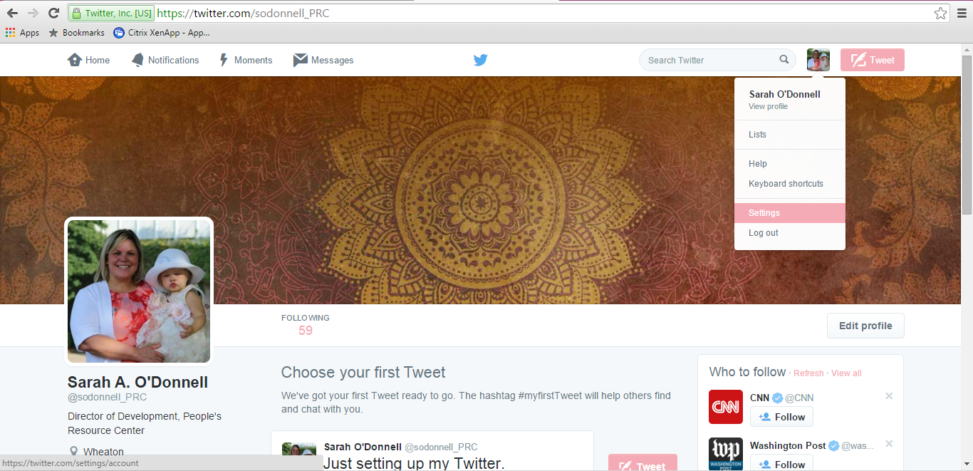
STEP 21: EDIT YOUR SETTINGS

Slide 32
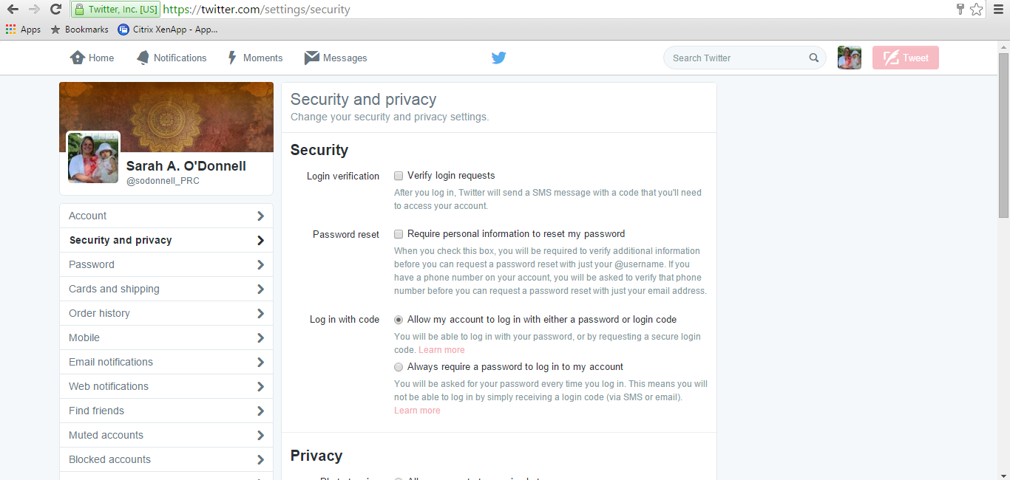
STEP 22: IN SETTINGS, EDIT YOUR SECURITY AND PRIVACY

Slide 33
STEP 22: IN SETTINGS, EDIT YOUR SECURITY AND PRIVACY

Slide 34
STEP 22: IN SETTINGS, EDIT YOUR SECURITY AND PRIVACY

Slide 35
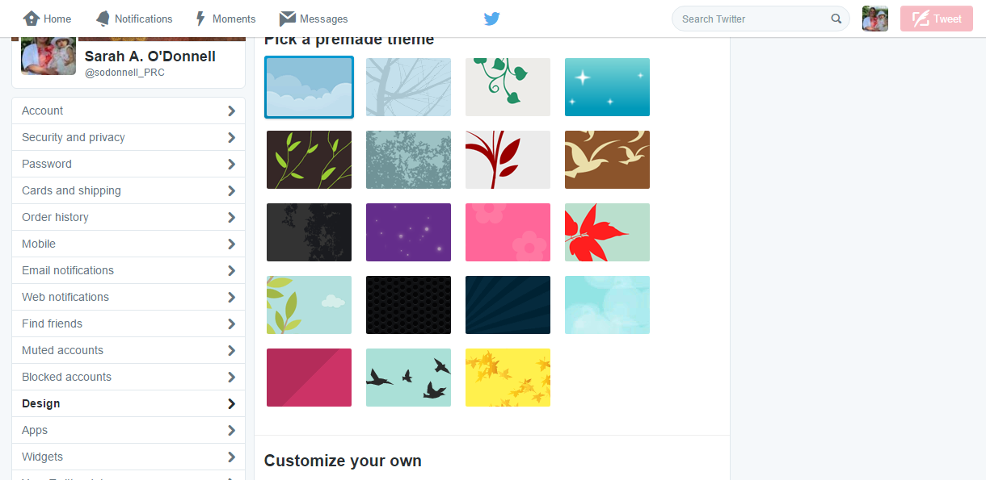
STEP 22: IN SETTINGS, CHANGE YOUR BACKGROUND, PASSWORD, NOTIFICATIONS, ETC.

Slide 36
STEP 23: NOTIFICATIONS

Slide 37
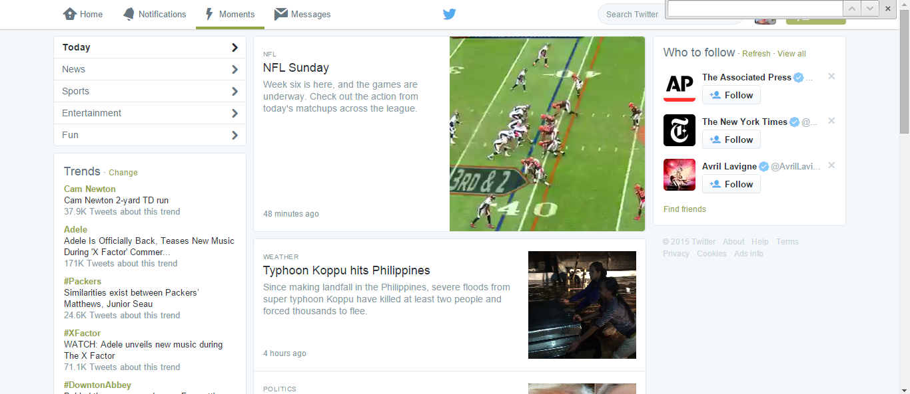
STEP 24: MOMENTS (AKA TRENDING)

Slide 38
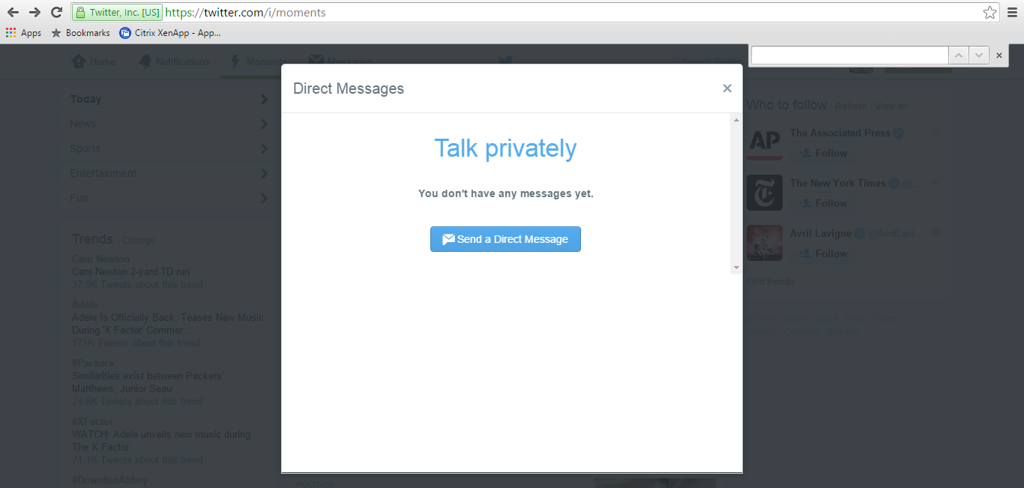
STEP 25: CHAT/MESSAGE PRIVATELY

Slide 39
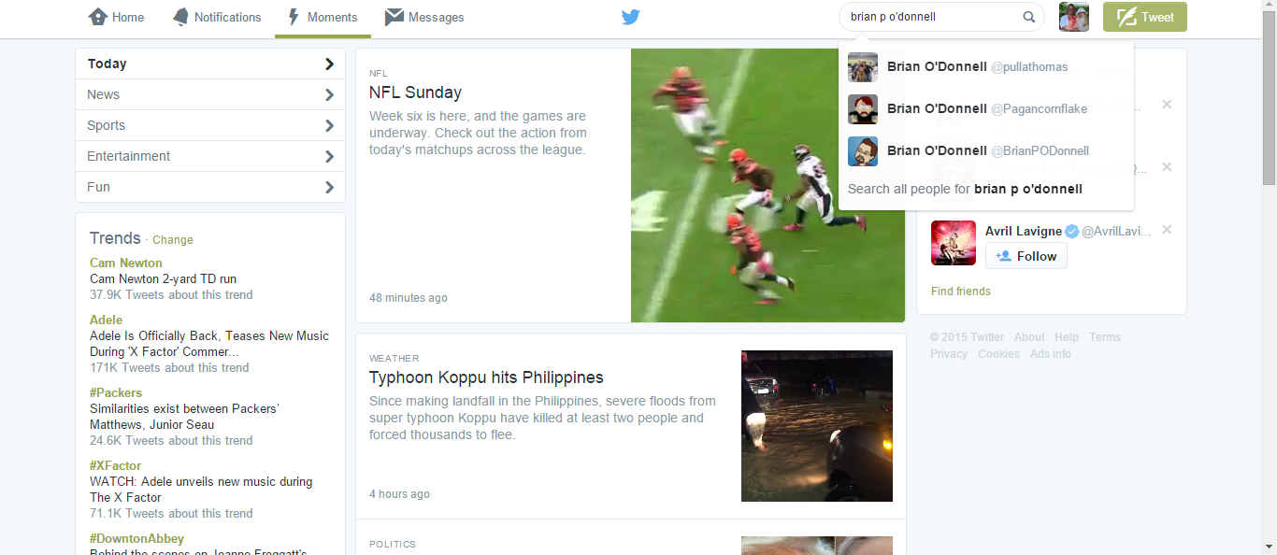
STEP 26: ADD PEOPLE YOU WOULD LIKE TO FOLLOW

Slide 40
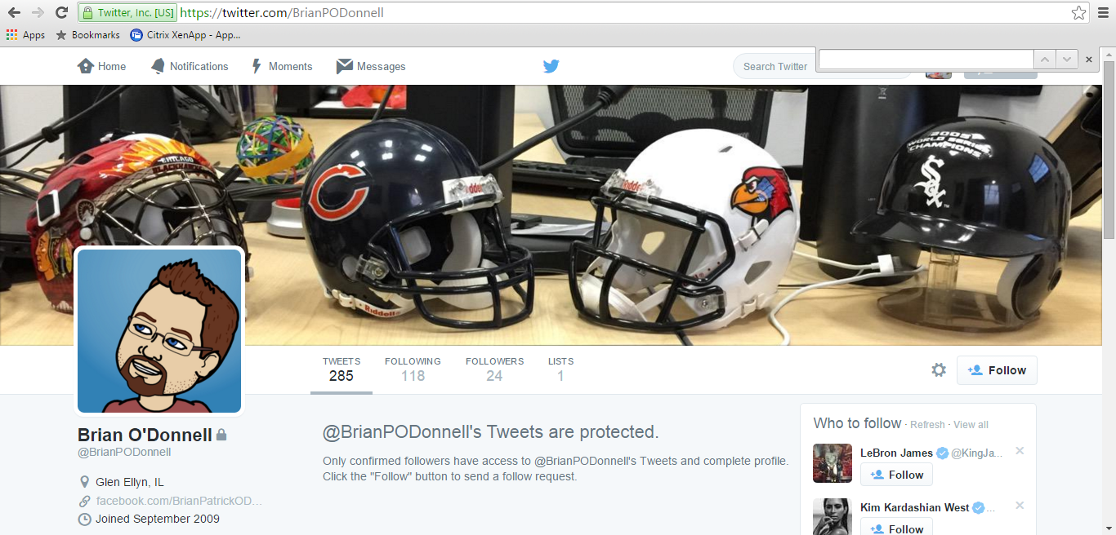
STEP 26: ADD PEOPLE YOU WOULD LIKE TO FOLLOW

Slide 41
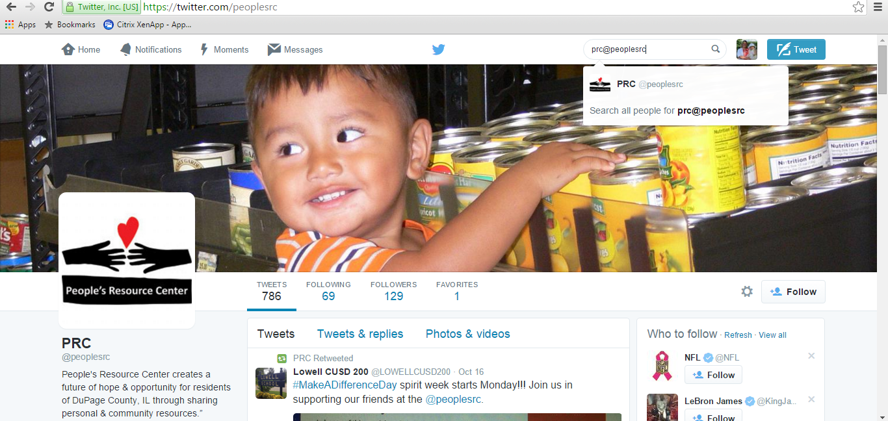
STEP 26: ADD PEOPLE YOU WOULD LIKE TO FOLLOW
PRC@PEOPLESRC

Slide 42
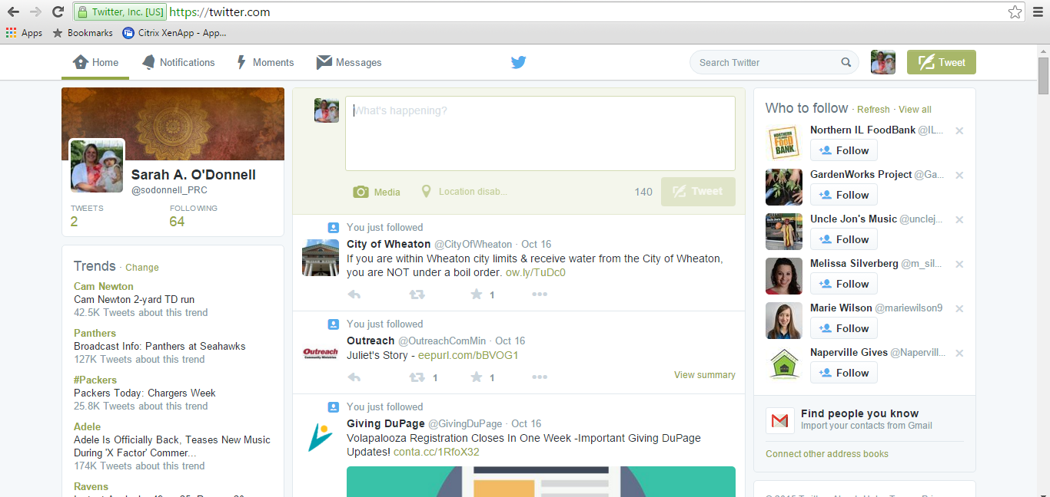
STEP 27: TWEETING A MESSAGE…BUT WHAT’S A HASHTAG AND AN AT SYMBOL MEAN?
A # IS A WAY TO HYPERLINK AND TRACK METADATA.
@ IS A WAY TO TAG A PERSON/FOLLOWER ON TWITTER.

Slide 43
STEP 27: TWEETING A MESSAGE…BUT WHAT’S A HASHTAG AND AN AT SYMBOL MEAN?
A # IS A WAY TO HYPERLINK AND TRACK METADATA.
@ IS A WAY TO TAG A PERSON/FOLLOWER ON TWITTER.

Slide 44
STEP 28: RETWEETING SOMEONE ELSE’S TWEET OR FAVORITING IT.

Slide 45
STEP 29: REPLYING TO A TWEET ABOUT YOU OR YOUR PLACE.

