Slide 1
Online Learning #1
Massive Online Open Courses (MOOCs) & Pinterest

Slide 2
Some people imagine online learning as:
A student
a tool
Notes:
Student uses the tool to learn. The way you might use a book to learn a new skill.

Slide 3
Some people imagine online learning as:
A student
a teacher
Notes:
In this case, similar to a classroom, a student is directed by a teacher to learn new information or skills.

Slide 4
Online learning is more like:
A student
many tools
many teachers
many more students!
Notes:
In the late 1990’s educators began to talk about the potential for what was called at the time “distance learning.” At first distance learning, happened as a transaction driven by the student via email and listserve groups. It was slow and had high drop out rates. Very few students completed a course. As internet speed improved the ability to work real time, teachers began to see new potential. Universities all over the world began to develop courses which could include real time participation AND stored for future review.
We are still discovering how online learning can happen. It is has unknown potential because this type (both teachers and tools) of resource has never been accessible to so many people.

Slide 5
Two Models
Traditional
Lesson Based
Instructor Driven
Basically, a video of Classroom Instruction
Crowd Sourced
Question Based
Student Driven
Unpredictable, evolving content
Notes:
Right now, there are two standard models for how online learning happens: Traditional and Crowd Sourced. Traditional is a lot like the schools we are used to. A student signs up to watch a video of an instructor or you read and watch a mix of things, but basically—it feels very similar to what we’ve done in school. You might decide, in general what you want to learn about, then a teacher guides you through the material. Crowd Sourced learning is different way of getting the job done. When you “crowd source”, the student throws a question out to the crowd and then sifts through possible responses. It’s messier, it’s more active, but it’s also more specific. Googling and Wikipedia are crowd sources styles of online learning.

Slide 6
Traditional Model Massive Online Open Course also known as: “Moo-ks”
Notes:
Let’s talk about the MOST traditional, recognizable form of online learning: the Massive Online Open Course. (or Massive Open Online Course. The ‘O’s’ are reversible!) Did you know you can take classes at Harvard, MIT, Stanford and many other exclusive universities all over the world…for nothing? No cost. Yep.

Slide 7
Where can you study?
Non-profit MOOCs
For Profit MOOCs
edX
Stanford Online
Academic Earth
Khan Academy
FutureLearn
Coursera
OpenClassrooms
iversity
Notes:
There are both non-profit and for profit online education forums: including….(Have you heard of …?)

Slide 8
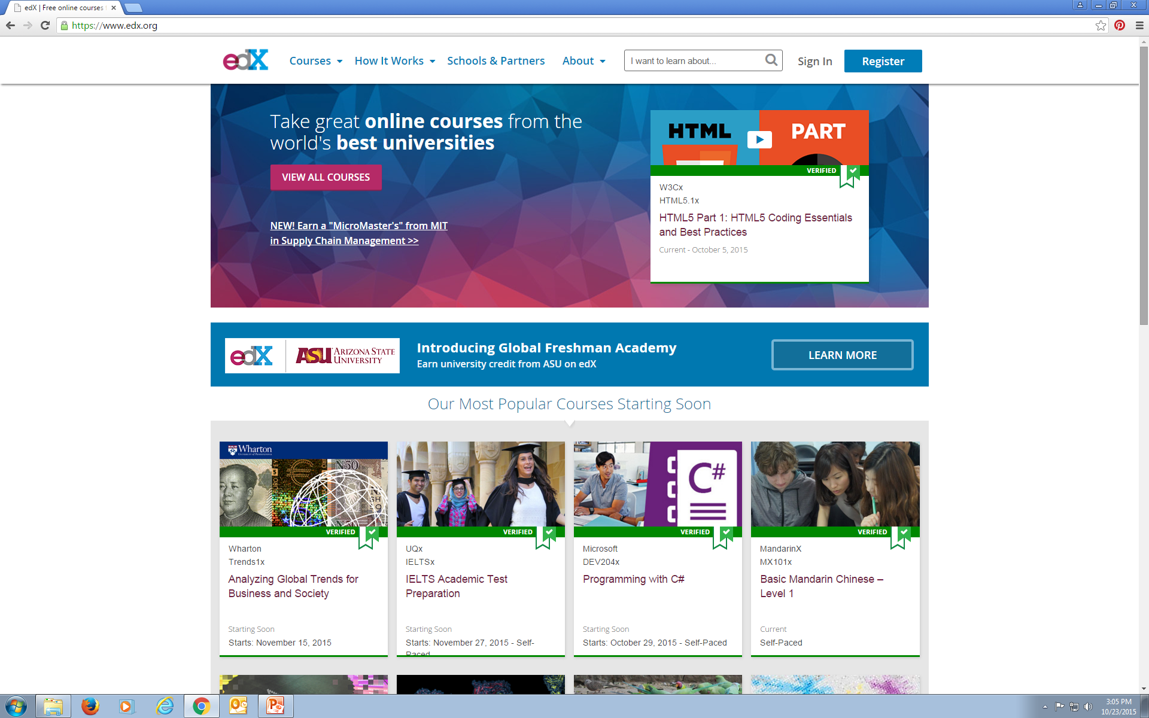
Notes:
This is the landing page for edX which is a non-profit, started by MIT and Harvard that includes 12 top universities from all over the world. Courses begin every week or so.

Slide 9
Refine your search
Availability
Current248
Starting Soon74
Upcoming98
Self-Paced144
Archived273
Subjects
Architecture8
Art & Culture54
Biology & Life Sciences73
Business & Management97
Chemistry27
Communication32
Computer Science133
Data Analysis & Statistics62
Design4
Economics & Finance62
Education & Teacher Training29
Electronics31
Energy & Earth Sciences12
Engineering119
Environmental Studies34
Ethics9
Food & Nutrition14
Health & Safety45
History59
Humanities114
Language11
Law20
Literature50
Math60
Medicine42
Music10
Philosophy & Ethics33
Physics64
Science105
Social Sciences104
LESS...
Refine your search
Availability
Current248
Starting Soon74
Upcoming98
Self-Paced144
Archived273
Subjects
Architecture8
Art & Culture54
Biology & Life Sciences73
Business & Management97
Chemistry27
Communication32
Computer Science133
Data Analysis & Statistics62
Design4
Economics & Finance62
Education & Teacher Training29
Electronics31
Energy & Earth Sciences12
Engineering119
Environmental Studies34
Ethics9
Food & Nutrition14
Health & Safety45
History59
Humanities114
Language11
Law20
Literature50
Math60
Medicine42
Music10
Philosophy & Ethics33
Physics64
Science105
Social Sciences104
LESS...
Notes:
The subject matter is WIDELY variable.

Slide 10
Refine your search
Availability
Current248
Starting Soon74
Upcoming98
Self-Paced144
Archived273
Subjects
Architecture8
Art & Culture54
Biology & Life Sciences73
Business & Management97
Chemistry27
Communication32
Computer Science133
Data Analysis & Statistics62
Design4
Economics & Finance62
Education & Teacher Training29
Electronics31
Energy & Earth Sciences12
Engineering119
Environmental Studies34
Ethics9
Food & Nutrition14
Health & Safety45
History59
Humanities114
Language11
Law20
Literature50
Math60
Medicine42
Music10
Philosophy & Ethics33
Physics64
Science105
Social Sciences104
LESS...
Refine your search
Availability
Current248
Starting Soon74
Upcoming98
Self-Paced144
Archived273
Subjects
Architecture8
Art & Culture54
Biology & Life Sciences73
Business & Management97
Chemistry27
Communication32
Computer Science133
Data Analysis & Statistics62
Design4
Economics & Finance62
Education & Teacher Training29
Electronics31
Energy & Earth Sciences12
Engineering119
Environmental Studies34
Ethics9
Food & Nutrition14
Health & Safety45
History59
Humanities114
Language11
Law20
Literature50
Math60
Medicine42
Music10
Philosophy & Ethics33
Physics64
Science105
Social Sciences104
LESS...
Currently,
689 Courses
available on EdX
Notes:
As of October 23rd, 2015, there were 689 courses available. Some are happening in real time. If you are a registered student, you will have the opportunity to interact with the professors via email and assignments, surveys or other measures. Some of the courses available are stored and you can only read or watch the lectures, and sometimes review the interactions of the students who DID participate.

Slide 11
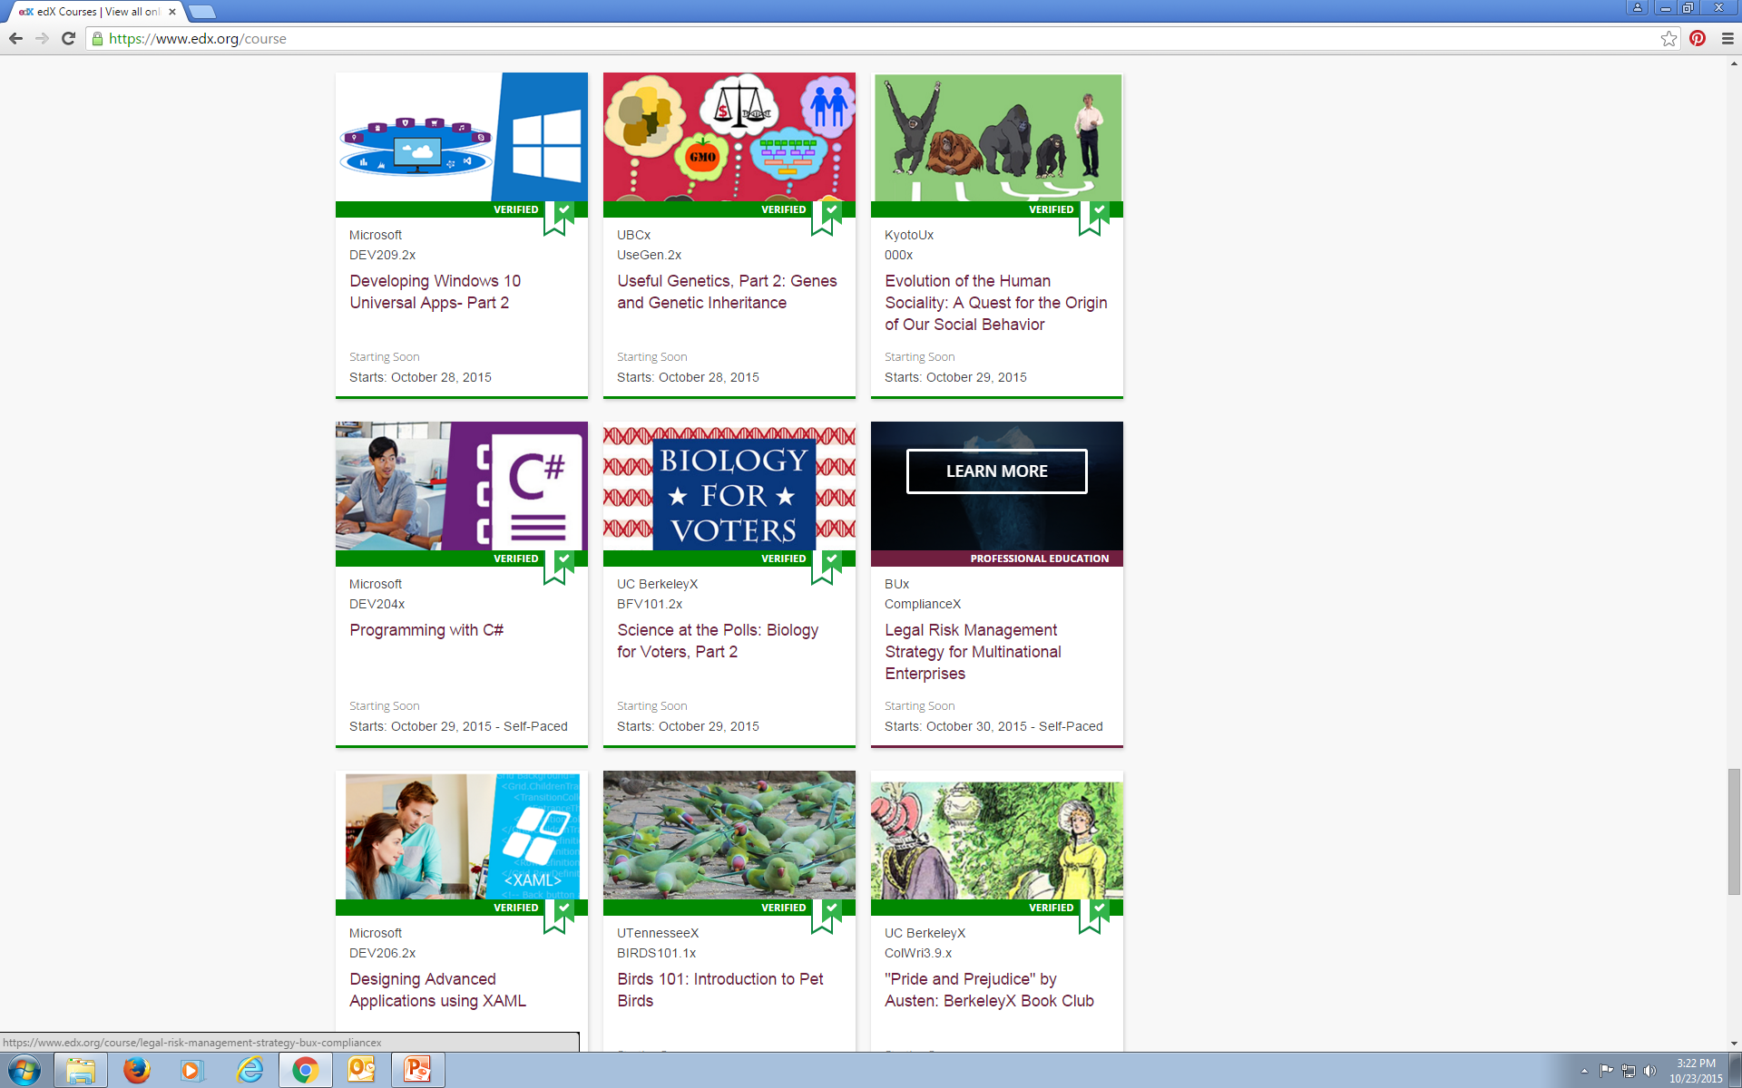
What can you study?
Starting this week:
Classes at Harvard
MIT, UC Berkley and
Kyoto U.
Oh, and
U of Tennessee:
“Intro to Pet Birds”
Notes:
It’s hard to get a sense for how wide and deep the choices are…here’s a screenshot of courses starting this week. (Pause and point out the various classes)

Slide 12
edX
Notes:
Hyperlink to enter the website and demo the landing page, how to search for classes by type and by start date, etc. Take your time and let people be amazed!

Slide 13
Crowd Source Model also known as:
“Time flies!”
Notes:
Remember there’s another form of online learning: the Crowd Source Model. Now, we’re going to take a look at Pintrest, which is a social media platform, that is also a place that has evolved into a learning environment. I have this cartoon here because, I find Pintrest to be a dangerous time suck. But if you stay focused you can find some great stuff.

Slide 14
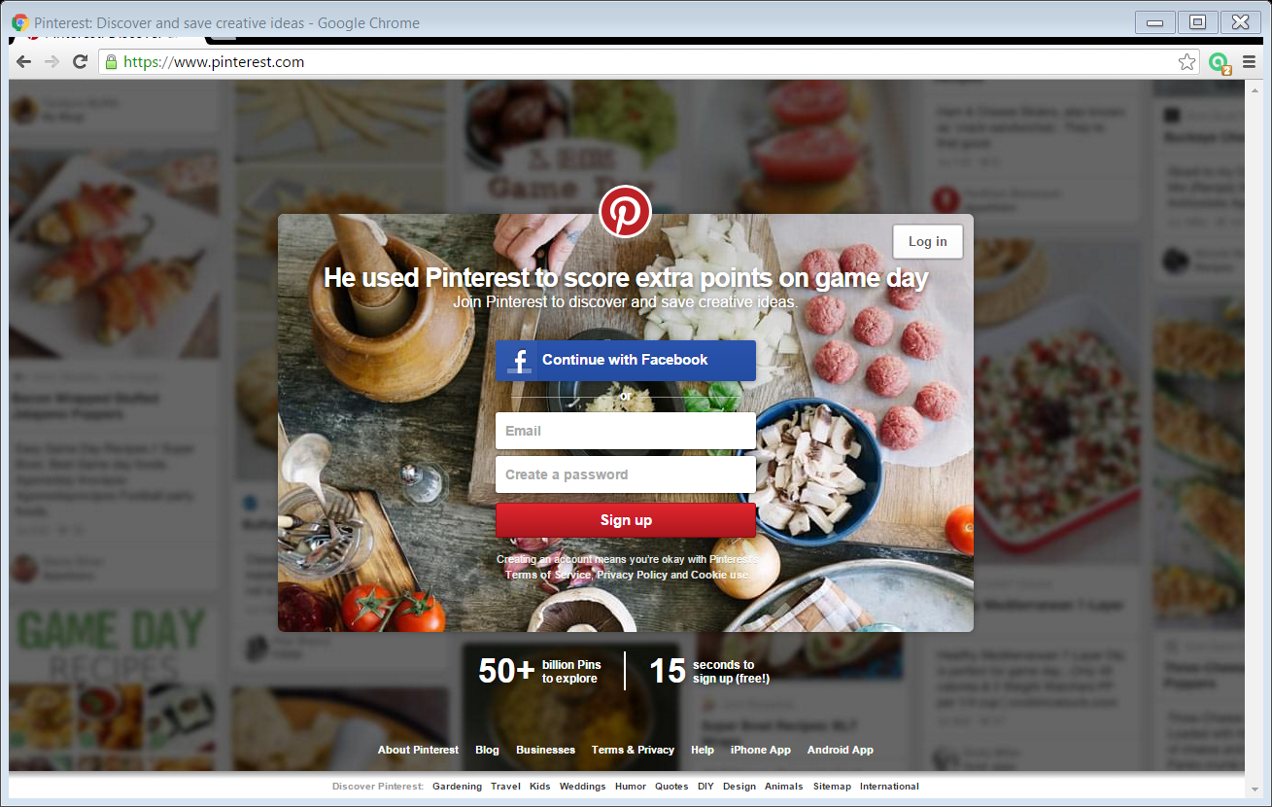
Notes:
Here’s a screenshot of the basic landing page. Pintrest is a free website that launched in 2010. The developer called it a “catalogue of ideas”; other people have described it as a “photo sharing” network. I think it’s like a visual catalog to the web. People save photos and links, using a “pin”. You may have seen the P icon for pinning on tool bars?

Slide 15
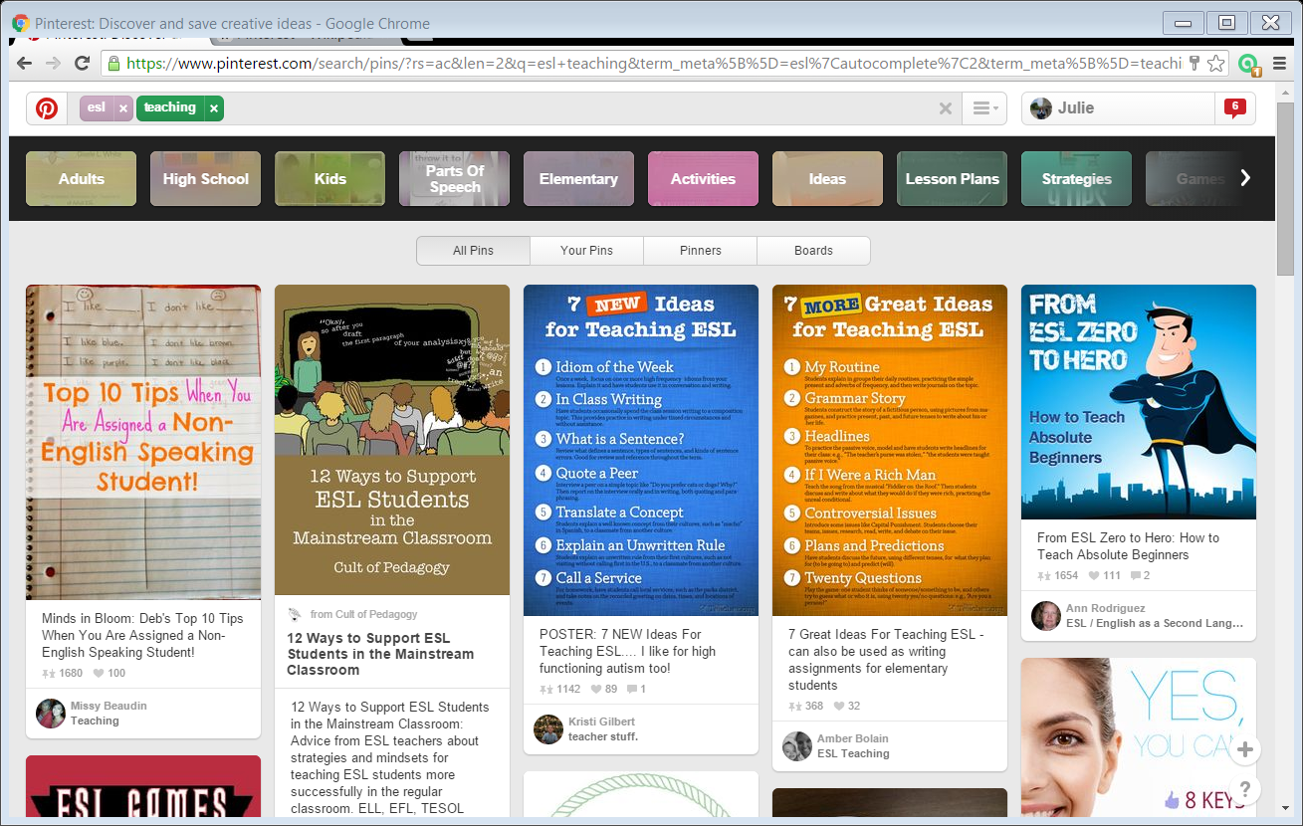
Notes:
OK—Here I’m logged in—you can see my name up there? And I have done a subject search for two topics: ESL and teaching and the boxes below are pins other people have added related to these topics.

Slide 16
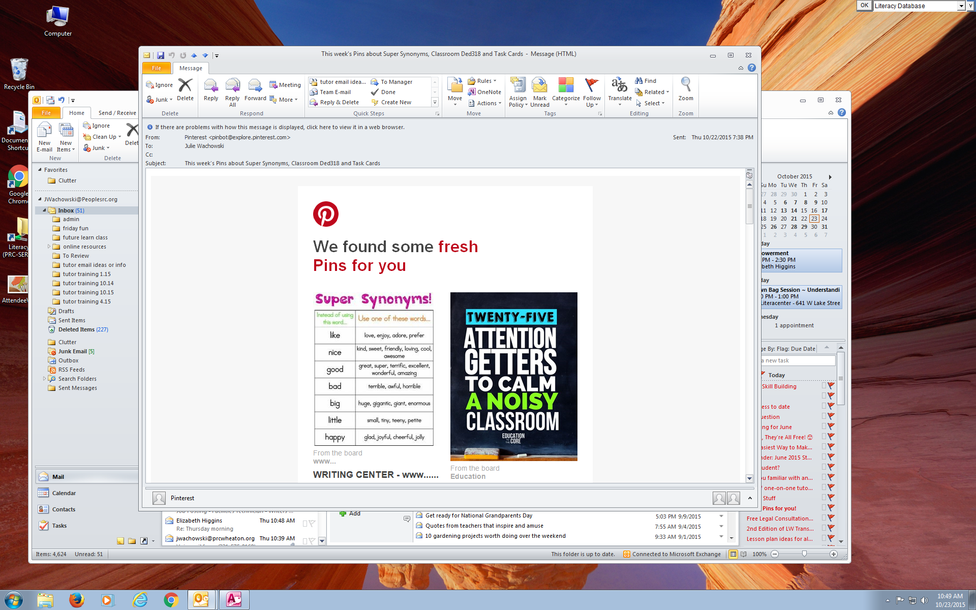
Notes:
I log into Pintrest with my email, so I also get emails every day or two related to things I’ve search. This is great for inspiration! But beware the time suck!

Slide 17
Pinterest
Notes:
Hyper link to the website. Demo walking them through the start. Ask for suggestions, things the students would like to see. Demo following the Pin to a website. Demo pinning the pin to a board.

Slide 18
Questions?
Stay tuned! Online Learning Part 2
TED & Khan: November 10

