Slide 1
Google Drive
by Robin O'Neill

Slide 2
What is Google Drive?
Created in 2006
Free storage - thousands of photos
Free word processing, spreadsheets, powerpoint presentations
Web based - no flash drive needed

Slide 3
How do I get it?
If you have gmail, you have it. OR
You can register in minutes @ drive.google.com. You can use any email address.

Slide 4
Who uses it?
Example: You work on a project during the day, and want to finish it at home. In the past, you would email it yourself or save it to a flash drive.
Now, you work on it in your Google Drive
(by uploading) and simply open it at home on your computer.

Slide 5
Example 2
Students would email papers to teachers. Working in Google Drive, you click the share button and enter an email address.

Slide 6
Example 3
You want input from others on documents. In the past you would email back and forth. Now, you can collaborate in live time, working at the same time. Your input is shown in different colored ink.

Slide 7
Publish to the Web
All documents (word processing, spreadsheets, presentations) can be published to the Web with a click. You can give the link to others.

Slide 8
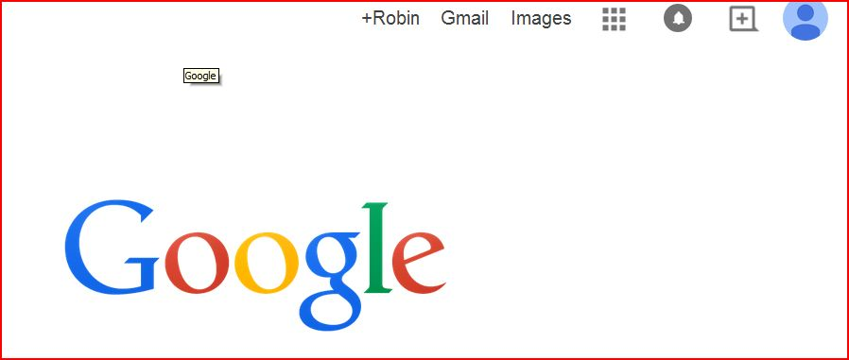
How do i get to Google Drive?
From the Google Browser, click on apps.

Slide 9
Uploading files
You can upload files from any computer. Simply click the upload button.
PRC students can upload all
training files.
No more missed homework!

Slide 10
Can I write my PHD dissertation on Google Docs?
No.
Can I create a glossy brochure? No.
Can I use Google Docs for many other things?
Yes!

Slide 11
Key Points:
Web based. You sign in like email. No flash drives needed.
Can be accessed from Iphones (for viewing, hard to edit based on size) or tablets.

Slide 12
Make forms. Survey results will be tallied in a spreadsheet for you.
Ex. You have a family reunion. Create a form asking name, how many will be attending, and hotel. Email the form, and responses are tallied for you!

Slide 13
Ex. You are holding a meeting. Create a form with the info you need, email, and results are automatically tabulated.
https://www.youtube.com/watch?v=22eVYplSJQ8

Slide 14
Google docs
short video on google docs
https://www.youtube.com/watch?v=WnslL_yei0s

Slide 15
Sources:
Google Drive & Docs by Ian Lamont
Available at many libraries.
Notes:
show your drive.

