Slide 1
Ever wanted to hunt for treasure?

Slide 2
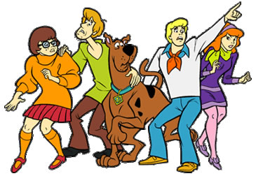
Do you recognize these people?
m

Slide 3
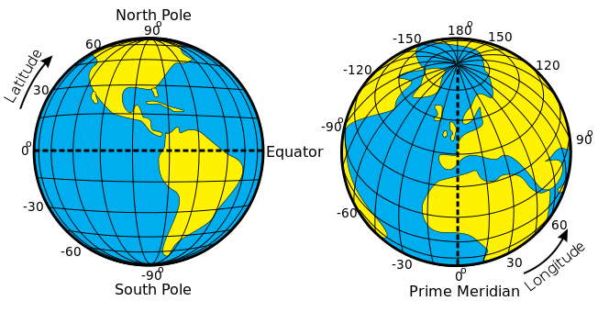
Do you like to walk outdoors?

Slide 4
OR: Tech CAN be Fun!

Slide 5
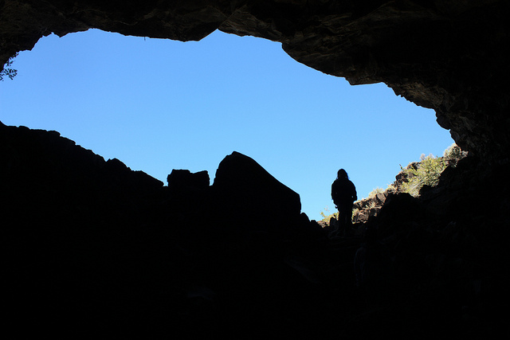
What’s a Cache?
“A hiding place for goods, provisions, ammunition, treasure, etc….”
Notes:
Geocaching is a scavenger hunt using GPS coordinates to find a hidden object.

Slide 6
“IRL Adventure Gaming!”
You need:
GPS device
Coordinates to the cache
Or a Cache app loaded on your phone
Notes:
I’ve gone out with my kids and my nephews. With a GPS sensitive app downloaded to my phone, we’ve used coordinates and clues to locate nearby caches—small containers of hidden treasure. In this case “treasure” is defined as typical kid detritus (a lego figure, one nickel, mardi gras beads, a dentist’s jeweled ring or a lick-on tattoo.)

Slide 7
2 million active geocaches
in 185 countries.

Slide 9
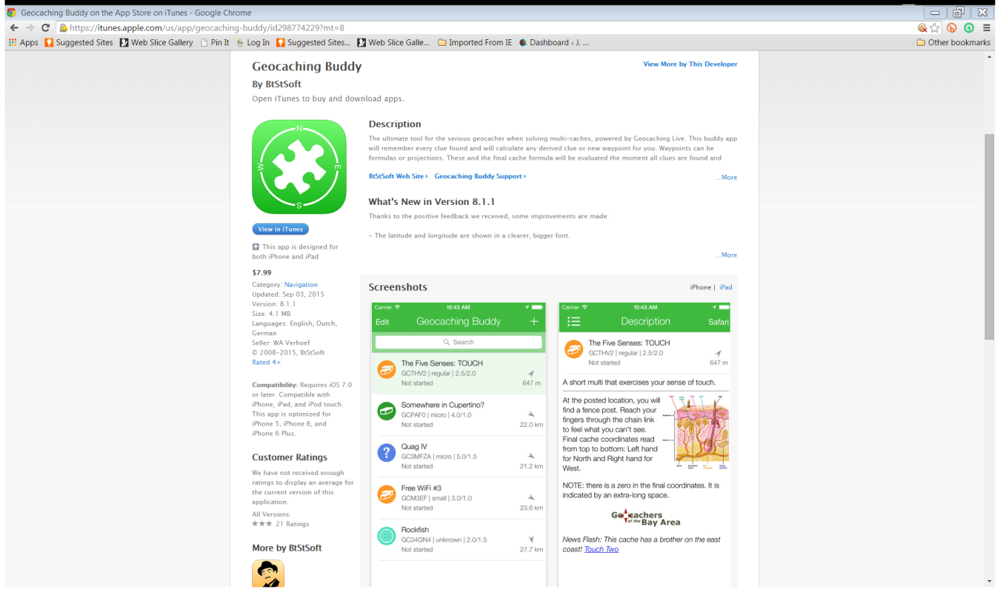
Geocaching Apps
Geocaching by Groundspeak
Geocaching Buddy
Android only: C:geo

Slide 10
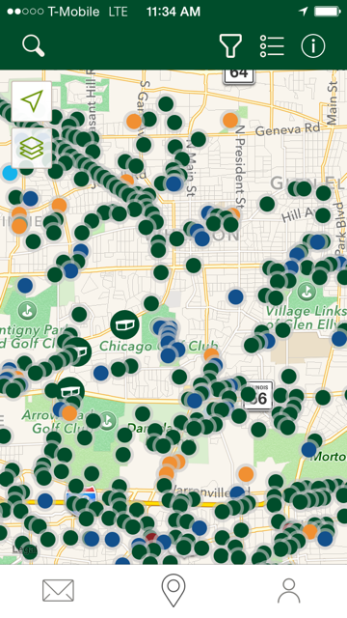
Look at all those mysteries!
Notes:
Notice the green, blue, orange? Notice how they line up along a route?

Slide 11
Speak the lingo
IRL= in real life
Traditional, Mystery & Multi-caches=different types of caches. Mystery & Multis are hardest
CITO= Cache In Trash Out

Slide 12
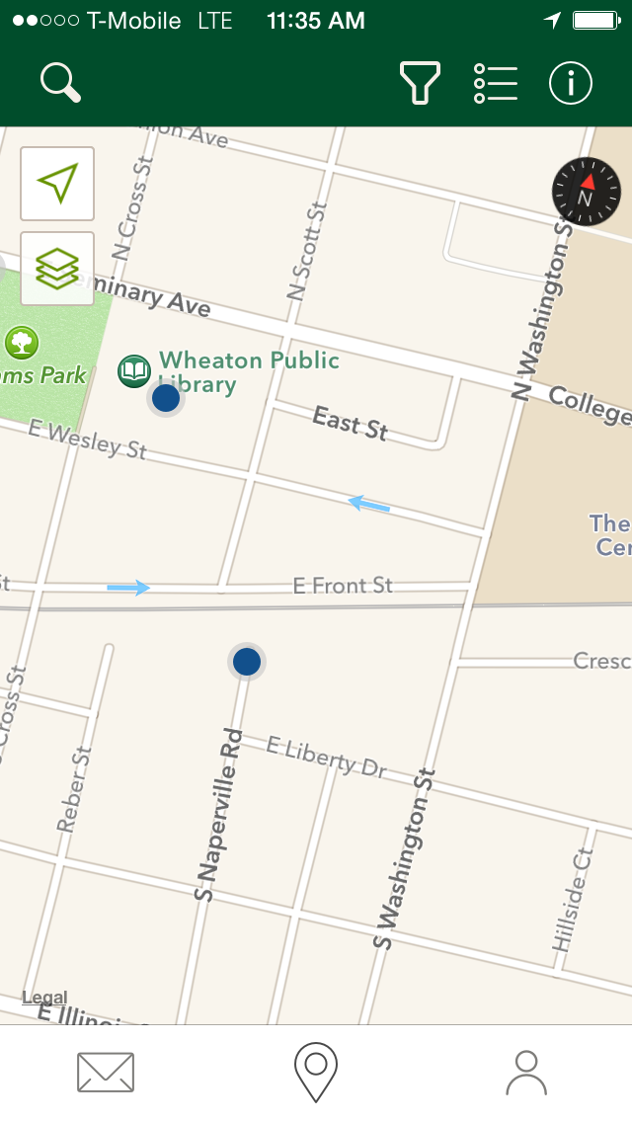
Notes:
Zooming in to see what’s near us…look at that!

Slide 13
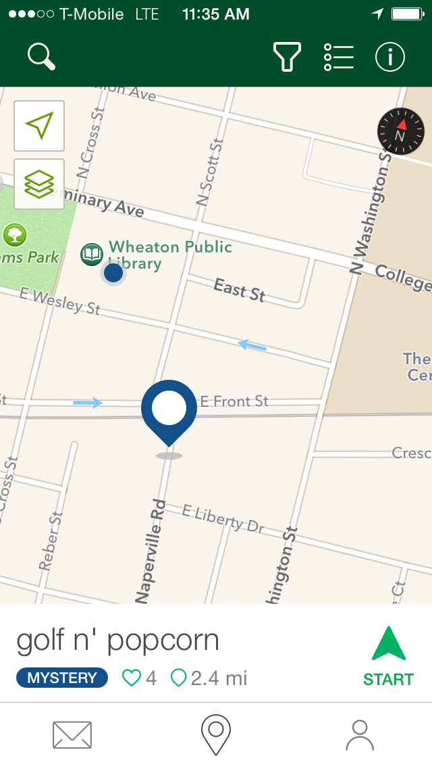
Notes:
Clicking on the blue dot & here’s what you see.

Slide 14
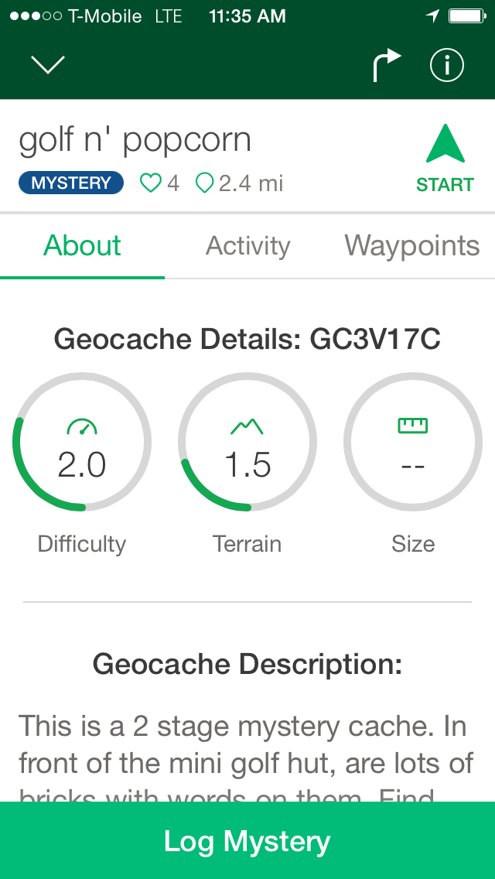
Notes:
Here are the details

Slide 15
Speak the lingo
Difficulty= how hard a cache is to find rated on a scale from 1-5. A 2 is “relatively easy to find within 30 minutes.”
Terrain=an evaluation of the hike/walk. A 1-1.5 is “most likely flat” but may not be wheelchair accessible.
Size=how big is the cache? Micro (or Nano), Small, Regular or Large.

Slide 16
Speak the lingo
Size=how big is the cache?
Micro (or Nano). Bolt.
Small. Sandwich
Regular. Shoebox
Large. “Bigfoot’s shoebox.”
Unknown. When knowing the size would give away the surprise of the find.
BYOP=bring your own pencil
Notes:
After you find the treasure, you sign the “logbook” inside. Sometimes these are very small.

Slide 17
Notes:
Let’s take a closer look at the description…

Slide 18
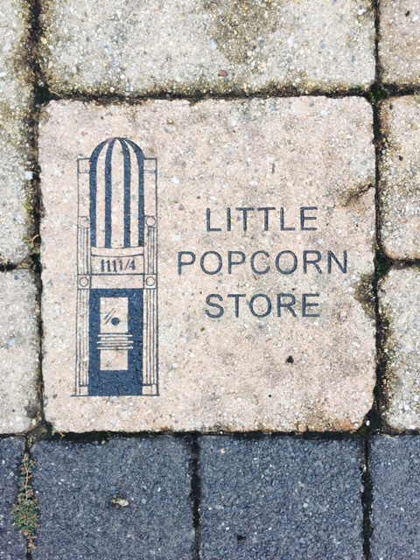

Slide 20
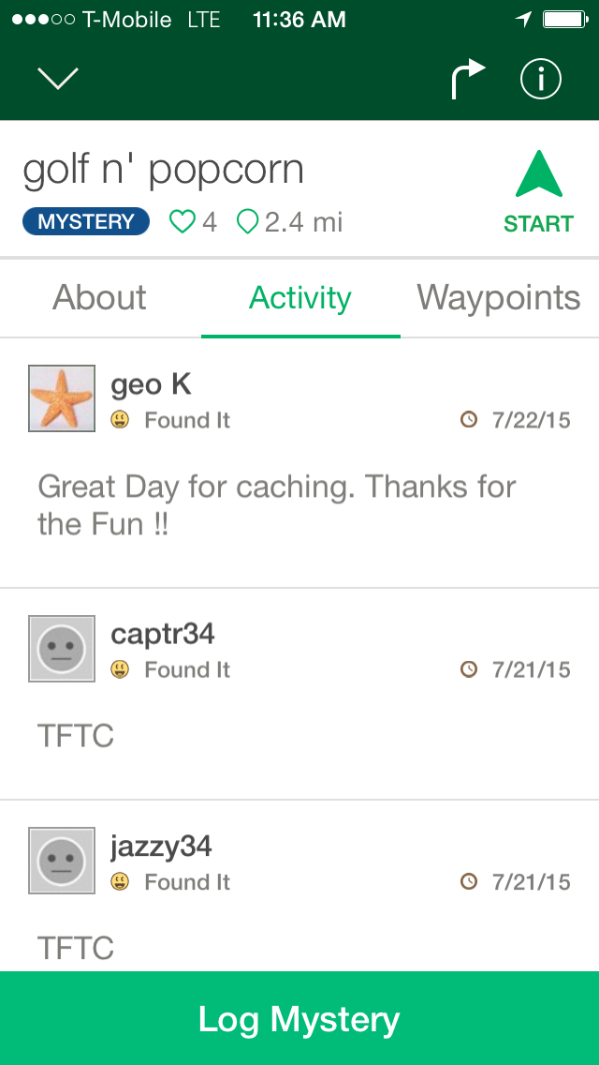

Slide 21
Speak the lingo
TFTC!= “Thanks for the Cache!” people post this online after they find a cache
GZ=ground zero.
Smiley=finding a cache
Trackables
Notes:
After you find and log 100 caches, including a trackable, you can hide a cache of your own.

