Slide 1
Tech Tuesday: Facebook 101
People’s Resource Center
January 26, 2016

Slide 2
What is Facebook?
Facebook is a social networking website that makes it easy for you to connect and share with your family and friends online.
Today, Facebook is the world's largest social network, with more than 1 billion users worldwide.

Slide 3
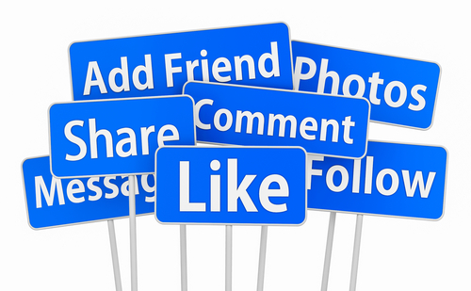
Facebook Definitions
Comment - Whenever your friends share on Facebook, you can leave a comment about their posts.
Friend - You can add people you know as friends on Facebook. Your friends will see the things you share, such as status updates or photos. Friends will also be able to view your profile information and share things on your Timeline.
Like - Whenever your friends share something on Facebook, you can choose to like the post. This is just a simple way of showing your friends that you enjoyed what they shared. You can also like the Facebook Page for certain businesses and organizations to receive updates about them in your News Feed.
News Feed - The News feed is a stream of updates from your friends and any Facebook Pages you follow. This is where You'll probably spend most of your time on Facebook, since it's where you can view and comment on what's happening with all of your friends.
Notifications - You'll receive a notification in an email message and on your Home page whenever someone interacts with you on Facebook. For example, you'll be notified when someone adds you as a friend, likes or comments on something you've shared, or sends you a private message.
Status Updates - One of the most common things people share on Facebook are status updates—short, text-based posts that your friends can see and comment on. You can also post other things, like photos, videos, links, and more. Your friends will be able to see your posts on their News feeds, and the things you share will also be posted to your Timeline.
Tag - Friends can tag you in photos and posts they share on Facebook. Posts you're tagged in will appear on your Timeline.
Timeline - Also known as your profile page, the Timeline is where You'll share information about yourself on Facebook. For example, it's where You'll post your profile picture, share basic information about yourself, and more. Whenever you share something on Facebook, it will appear on your Timeline, as well as your friends' News Feeds.

Slide 4
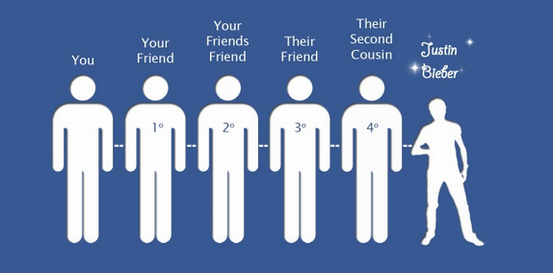
Why use Facebook?
Facebook is unique in its ability to connect and share with the people you care about at the same time.
Facebook is so popular, other websites have worked to integrate Facebook. This means you can use a single Facebook account to sign in to different services across the Web.

Slide 6
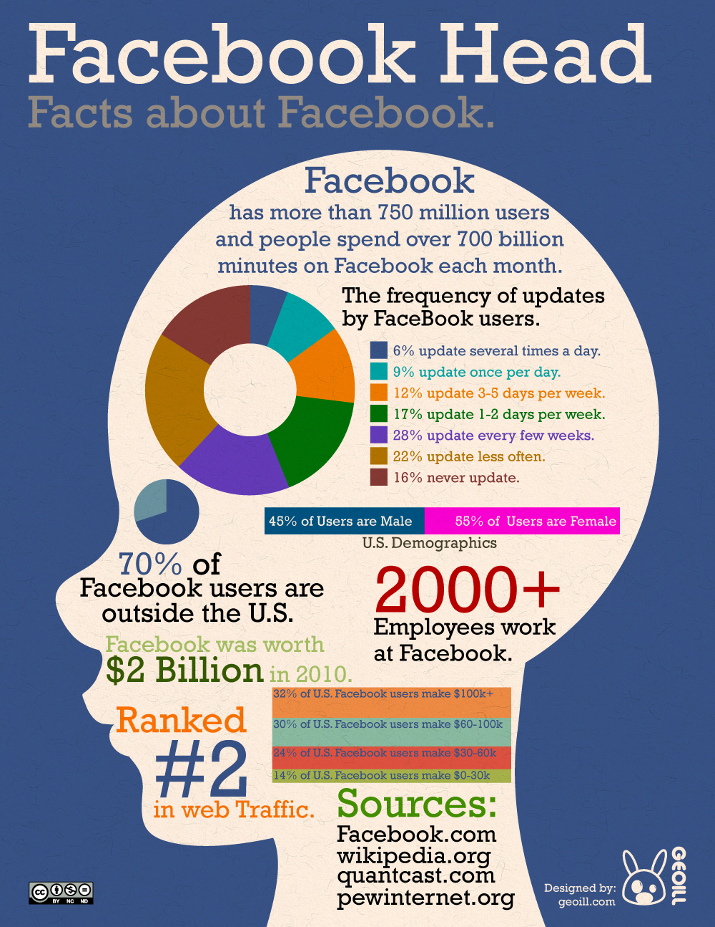

Slide 8
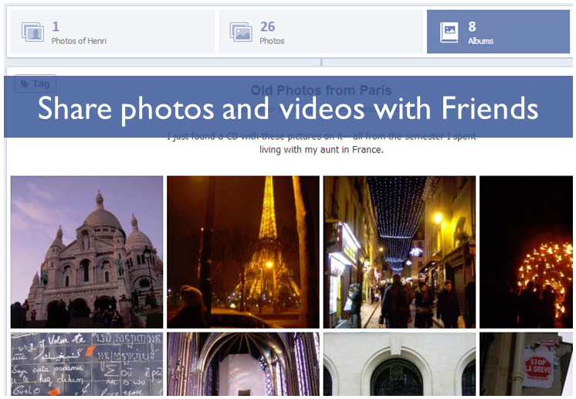

Slide 9
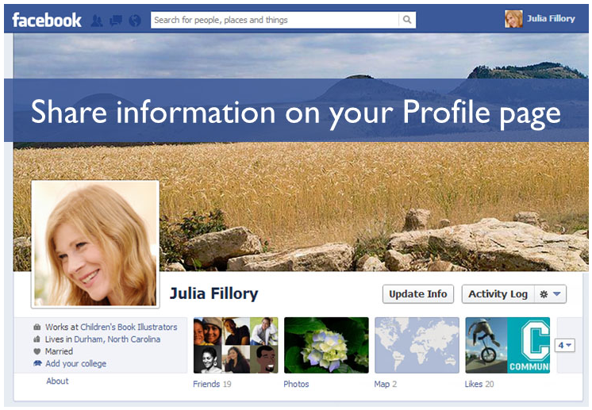

Slide 10
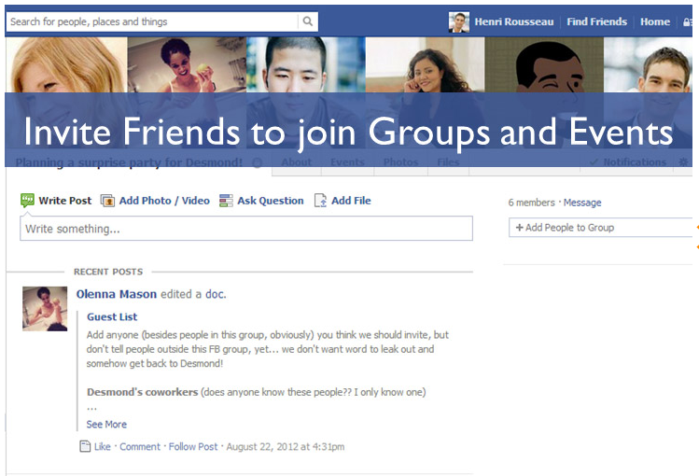

Slide 11
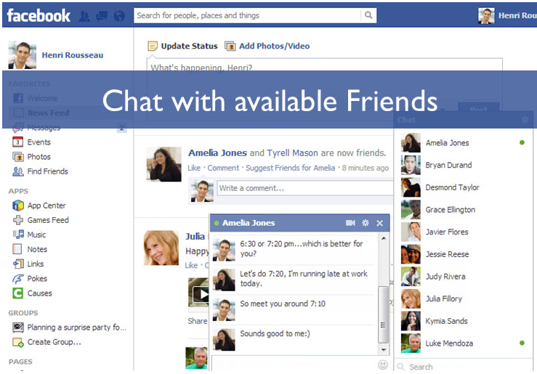

Slide 12
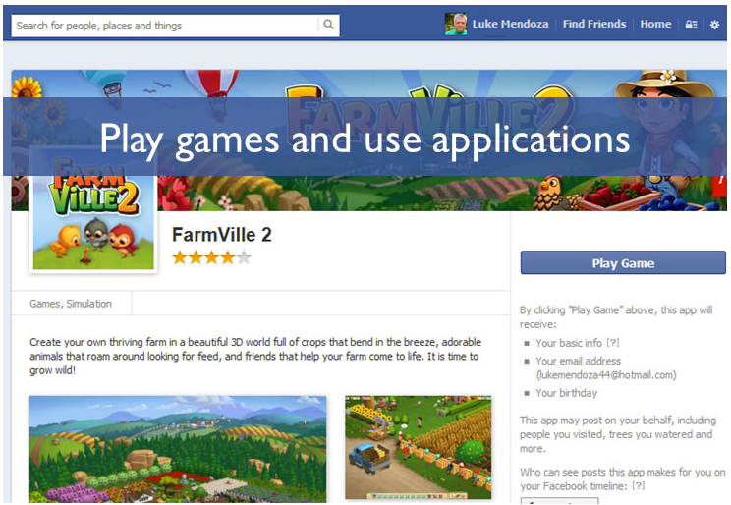

Slide 13
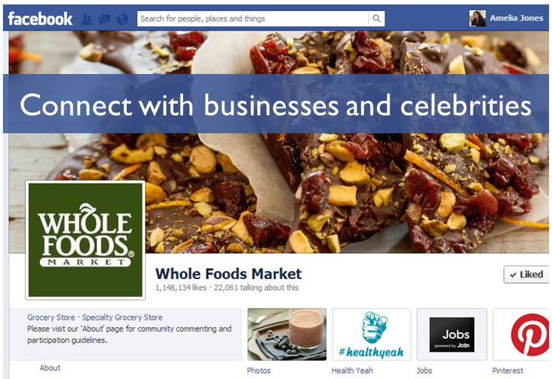

Slide 14
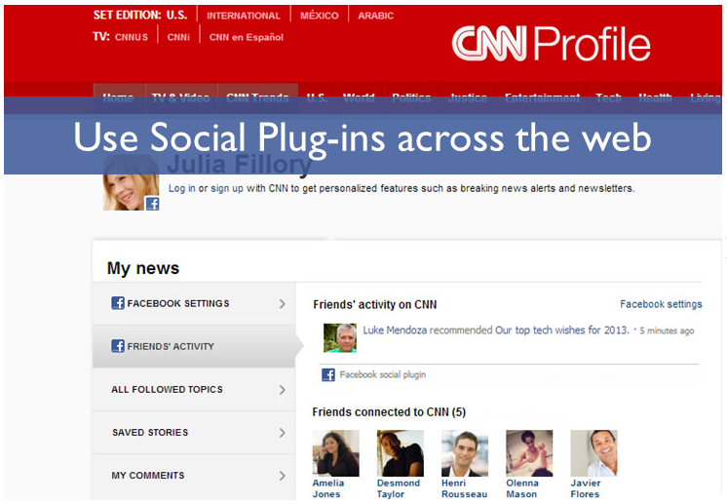

Slide 15
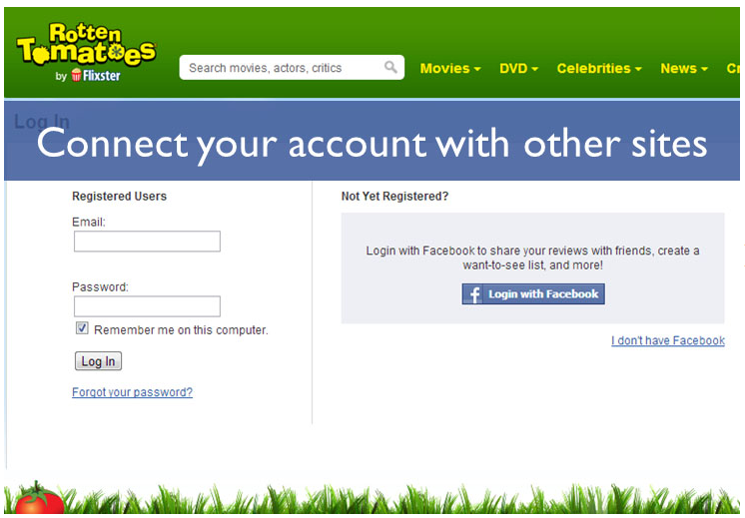

Slide 16
How does Facebook sharing work?
Facebook allows you to send messages and post status updates to keep in touch with your friends and family.
You can also share different types of content such as photos, links, and more.
Unlike email or instant messaging, which are relatively private, the things you share on Facebook are more public, which means they'll usually be seen by lots of other people.
While Facebook offers privacy tools to help you limit who can see the things you share, it's important to understand that Facebook is designed to be more open and social than traditional communication tools.

Slide 17
Why is Facebook privacy important?
Video Link: http://www.gcflearnfree.org/facebook101/4
If you choose to share things publicly on Facebook, anyone with an account will be able to find and view your Facebook information, posts, and activity. This could impact your privacy in a variety of ways. For example:
You could be sharing personal information you’d rather keep private, such as your birth date and address.
Anything you post, such as photos, comments, and status updates, will be visible to people you don’t know.
Embarrassing or unflattering posts could negatively affect your personal and professional reputation.
Third-party websites and applications can access and share information from your Facebook account.
Understanding basic privacy settings
Whenever you share something on Facebook, you can choose who you'll share with. In the infographic below, you can see the most common sharing options, including Only me, Lists, Friends, and Public.

Slide 18
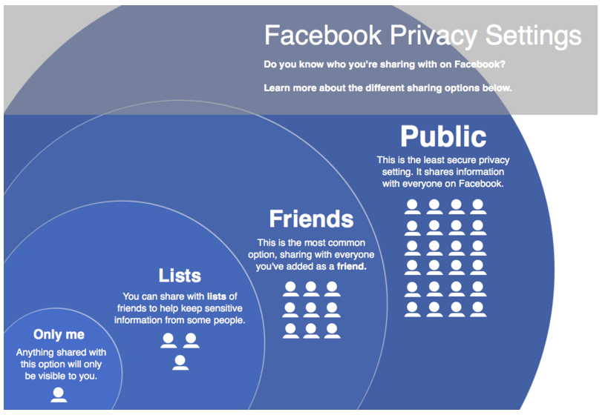
Understanding Facebook Privacy
Whenever you share something on Facebook, you can choose who you'll share with. In the infographic below, you can see the most common sharing options, including Only me, Lists, Friends, and Public.

Slide 19
Getting Started
Go to www.facebook.com
Complete the form
You will need to provide:
First Name
Last Name
Email Address or Cell Phone
Password (Make this a good one)
Male/Female
Birthdate

Slide 20
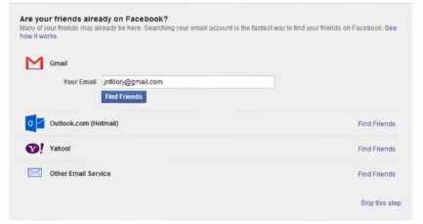
Connecting: Current Connections
After you setup your account, you will be asked to confirm your account through your email. Then, you will be prompted to connect with your friends that you might already have in your email contacts.

Slide 21
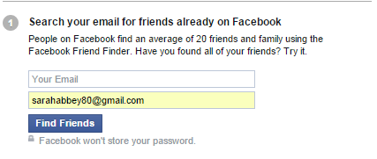
Connecting: Current Contacts

Slide 22
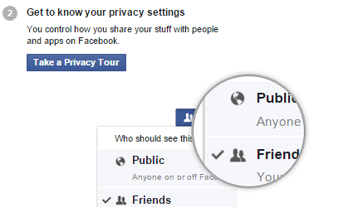
Connecting: Privacy

Slide 23
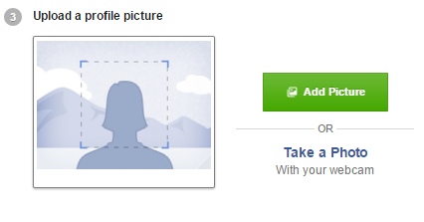
Connecting: Profile Photo

Slide 24
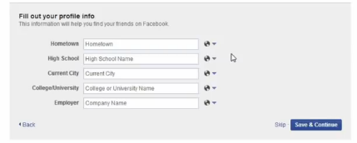
Connecting: Profile Info

Slide 25
Connecting: Find Friends

Slide 26
Hands On – Navigation Bar

Slide 27
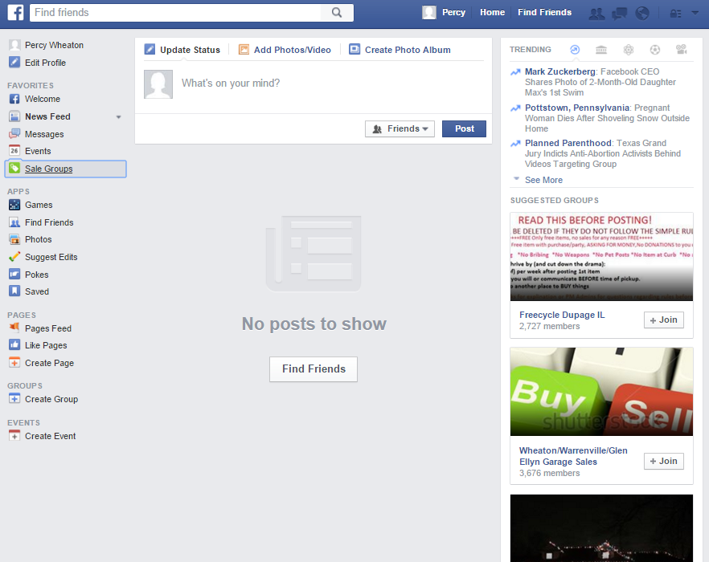
Hands On – Homepage

Slide 28
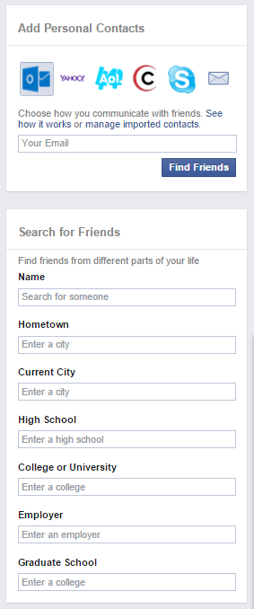
Hands On – Find Friends

Slide 29
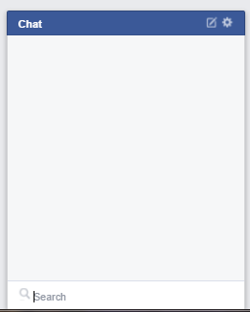
Hands On – Messages

Slide 30
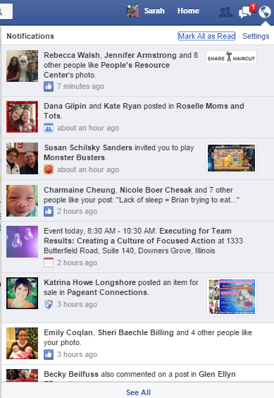
Hands On – Notifications

Slide 31
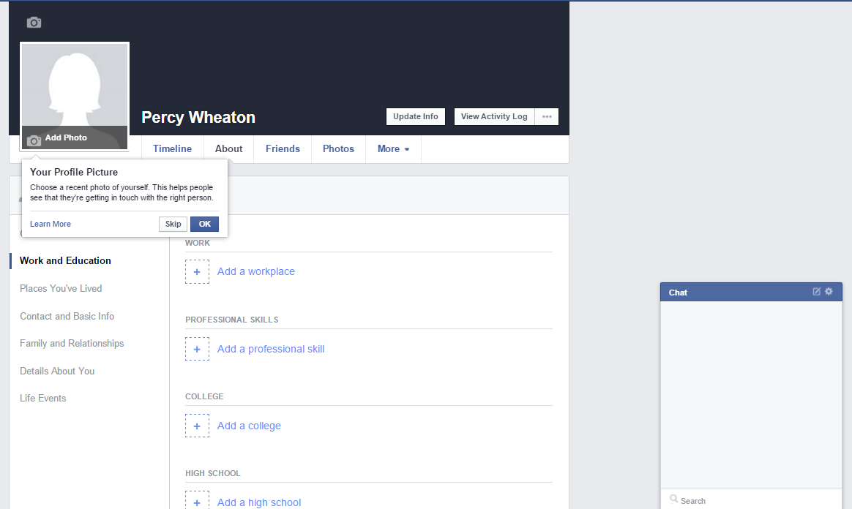
Hands On – Your Profile!

Slide 32
Hands On – Updating Your Status

Slide 33
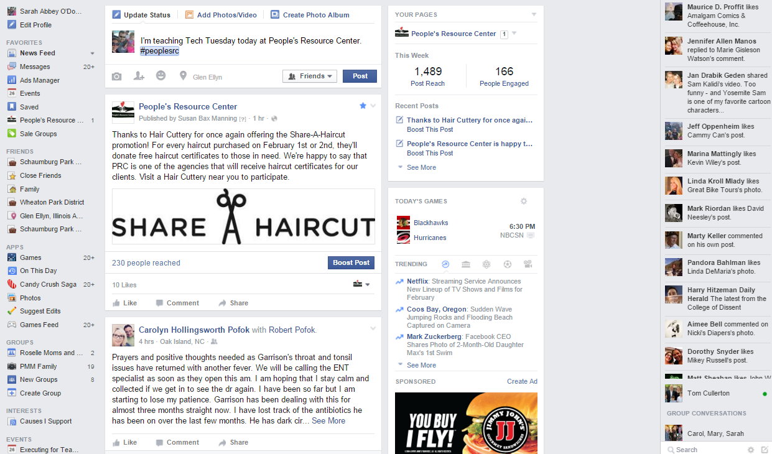
Hands On – Your Timeline

